Slide 1
Nursery/ Landscape CDE
Plant identification
(#’s 132-151)

Slide 2
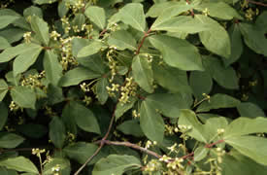
Winged Euonymus

Slide 3
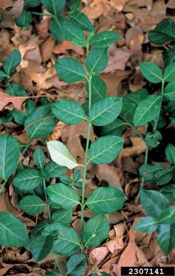
Wintercreeper

Slide 4
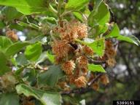
European Beech

Slide 5
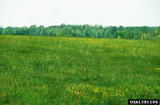
Fescue

Slide 6
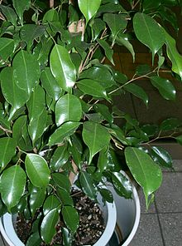
Benjamin Fig

Slide 7
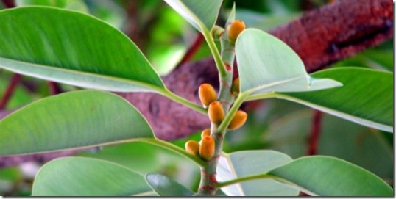
Decora Rubber Plant

Slide 8
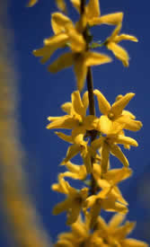
Border Forsythia

Slide 9
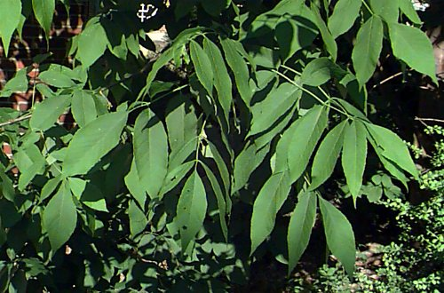
White Ash

Slide 10
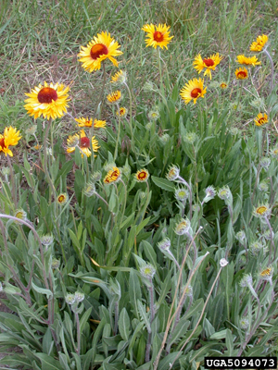
Common Blanketflower

Slide 11
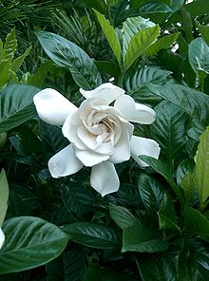
Common Gardenia

Slide 12
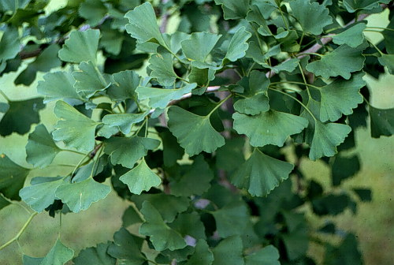
Ginkgo, Maidenhair Tree

Slide 13
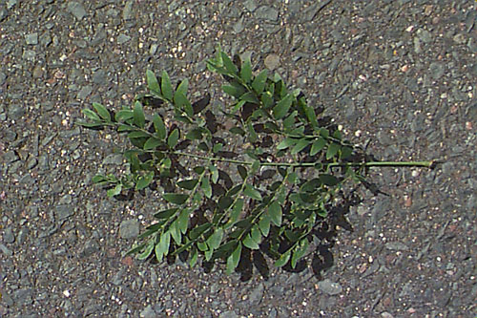
Thornless Honeylocust

Slide 14
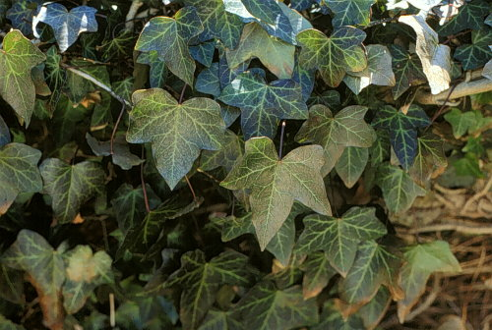
English Ivy

Slide 15
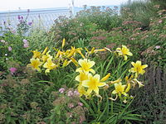
Day Lily

Slide 16
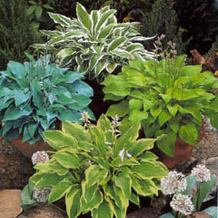
Plaintain Lily

Slide 17
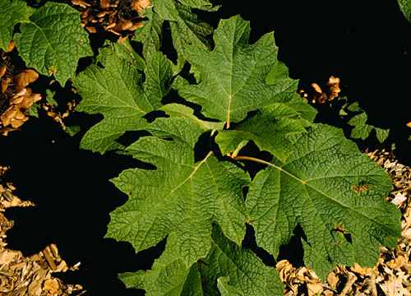
Oakleaf Hydrangea

Slide 18
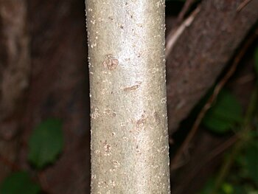
Chinese Holly

Slide 19
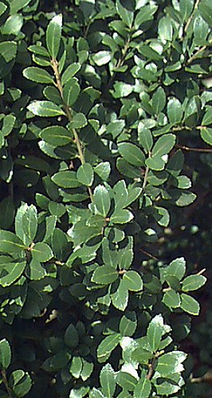
Japanese Holly

Slide 20
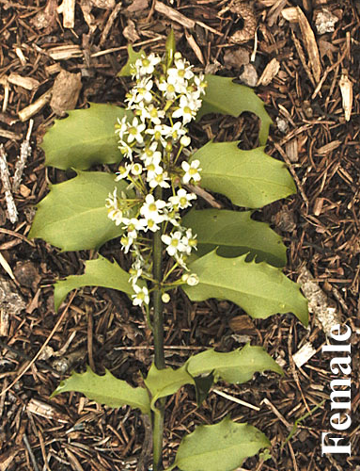
Meserve Holly

Slide 21
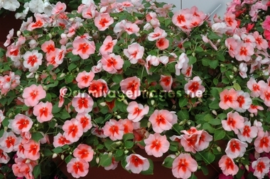
Impatiens

