Slide 1
FFA Nursery Landscape Weeds Identification

Slide 2
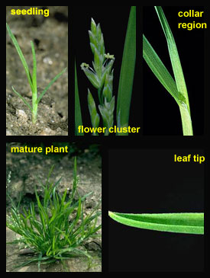
Annual Bluegrass

Slide 3
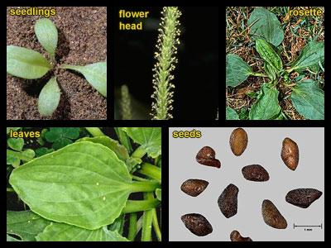
Broadleaf Plantain

Slide 4
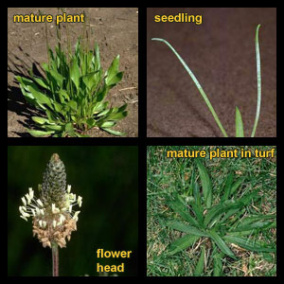
Buckhorn Plantain

Slide 5
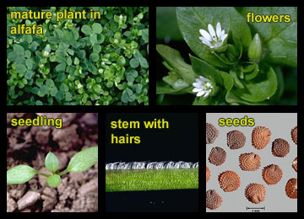
Chickweed

Slide 6
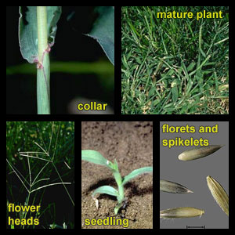
Crabgrass

Slide 7
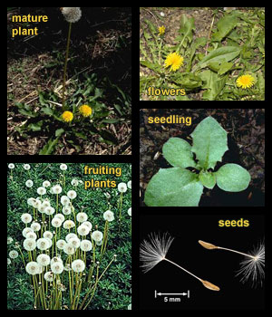
Dandelion

Slide 8
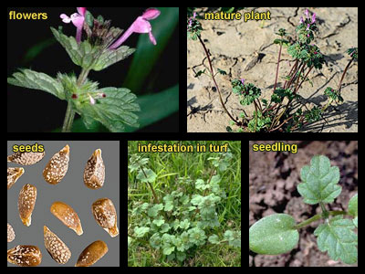
Henbit

Slide 9
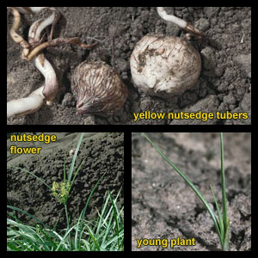
Nutsedge

Slide 10
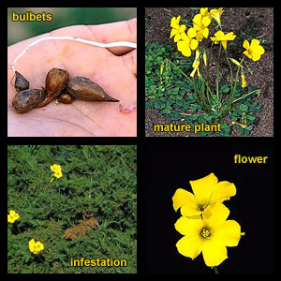
Oxalis

Slide 11
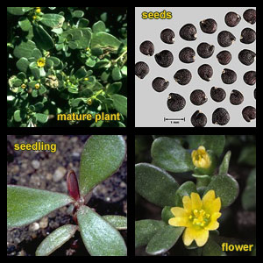
Purslane

Slide 12
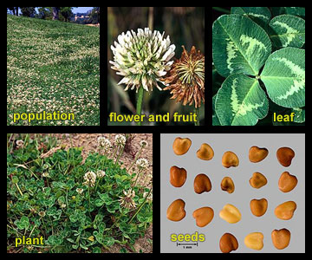
White Clover

