Slide 1
Plant ID. Slideshow #’s 173-194
FFA Nursery Landscape CDE

Slide 2
Fountain Grass Pennisetum ruppelia
Bunch grass around 3ft. tall and 18in. wide when fully grown
Mounded and upright
Tender Perennial
Flower spikes are Pink and/or Purple

Slide 3
Petunia Petunia x hybrida

Slide 4
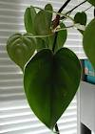
Heartleaf Philodendron Philodendron scandens oxycardium

Slide 5
Norway Spruce Picea abies

Slide 6
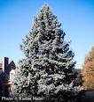
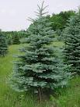
Colorado (Blue) Spruce Picea pungens

Slide 7
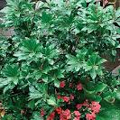
Lily-of-the-Valley Bush Pieris japoonica

Slide 8
Mugo Pine Pinus mugo
Mugo Pine without Pruning.
25 Year Old Mugo Pine

Slide 9
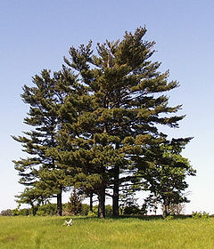
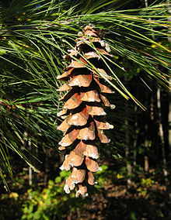
Eastern White Pine Pinus strobus

Slide 10
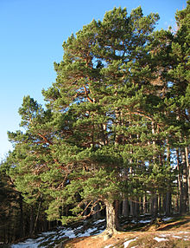
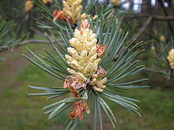
Scotch Pine Pinus sylvestris

Slide 11
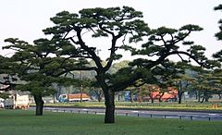
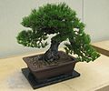
Japanese Black Pine Pinus thunbergiana

Slide 12
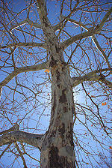
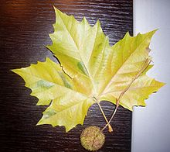
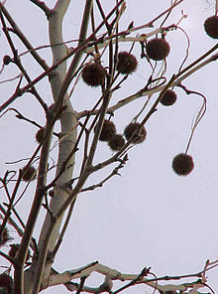
London Planetree Platanus x acerifolia

Slide 13
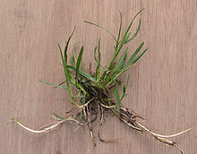
Kentucky Bluegrass Poa pratensis

Slide 14
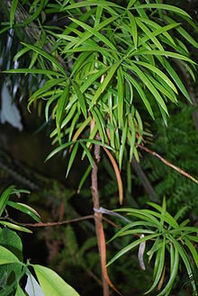
Southern Yew Podocarpus macrophyllus

Slide 15
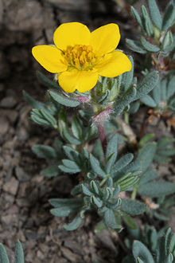
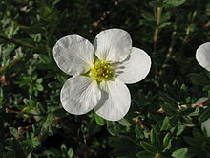
Shrubby Cinquefoil Potentilla fruticosa

Slide 16
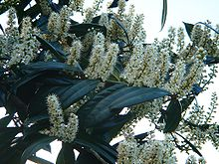
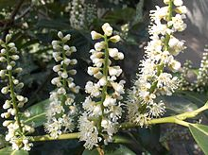
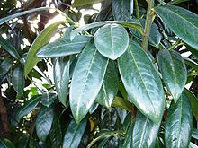
Cherry Laurel Prunus laurocerasus

Slide 17
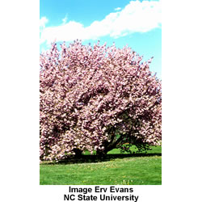
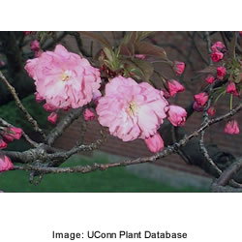
Kwanzan Japanese Flowering Cherry Prunus serrulata ‘Kwanzan’

Slide 18
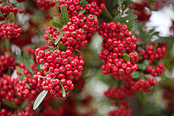
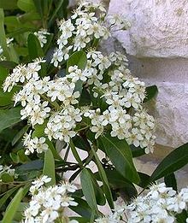
Firethorn Pyracantha coccinea

Slide 19
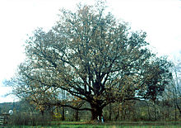
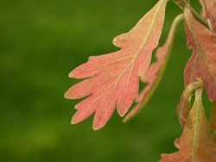
White Oak Quercus alba

Slide 20
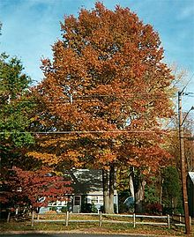
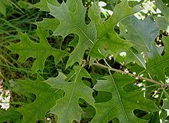
Pin Oak Quercus palustris

Slide 21
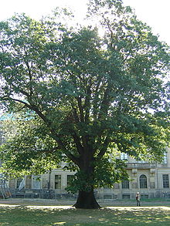
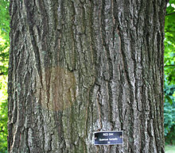
Red Oak Quercus rubra

Slide 22
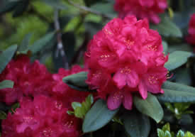
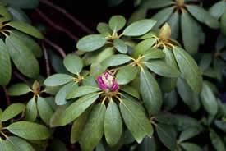
Catawba Hybrid Rhododendron Rhododendron x catawbiense

Slide 23
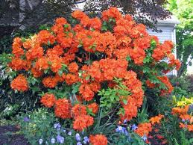
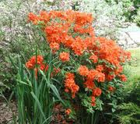
Exbury Hybrid Azalea Rhododendron Hybrid

Slide 24
That’s It! ☺
Be sure to check out wwwsouthernpridekennels.webstarts.com

