Slide 1
Floriculture Plant I.D.
#’s 206-224

Slide 2
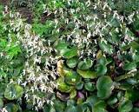
206. Saxifraga stolonifera/ Strawberry Plant

Slide 3
207. Schlumbergera bridgesii / Christmas Cactus

Slide 4
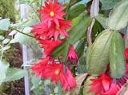
208.Schlumbergera truncata cv. /Thanksgiving Cactus, Crab Cactus

Slide 5
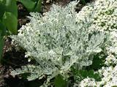
209.Senecio cineraria ‘Diamond’ / Diamond Dusty Miller

Slide 6
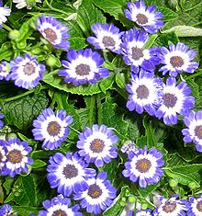
210. Senecio x hybridus cv. / Florist’s Cineraria

Slide 7
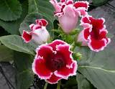
211. Sinningia speciosa Fyfiana Group / Gloxinia

Slide 8
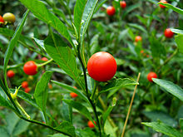
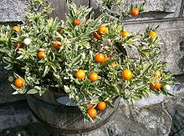
212. Solanum pseudocapsicum cv. / Jerusalem Cherry

Slide 9
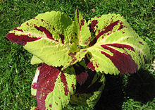
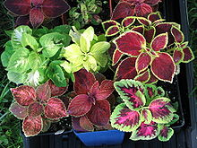
213. Solenostemon scutellarioides / Coleus

Slide 10
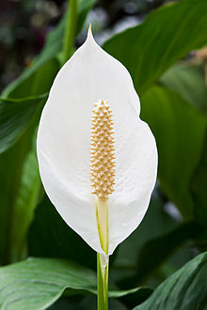
214. Spathiphyllum clevelandii / White Anthurium, Peace Lily

Slide 11
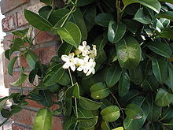
215. Stephanotis floribunda/ Stephanotis

Slide 12
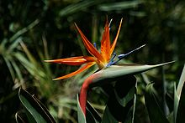
216.Strelitzia reginae/ Bird-of-Paradise

Slide 13
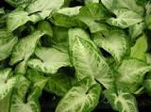
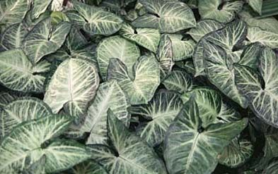
217. Syngonium podophyllum/ Nephthytis

Slide 14
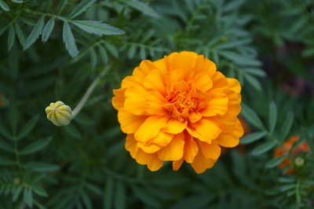
218. Tagetes species cv. / Marigold

Slide 15
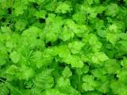
219. Tolmiea menziesii/ Pickaback plant

Slide 16
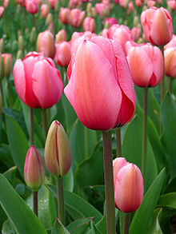
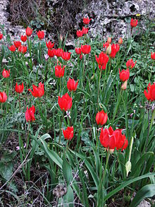
220. Tulipa cv. / Tulip

Slide 17
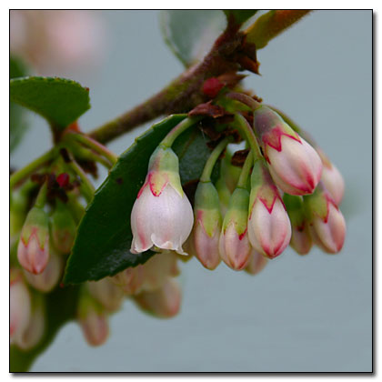
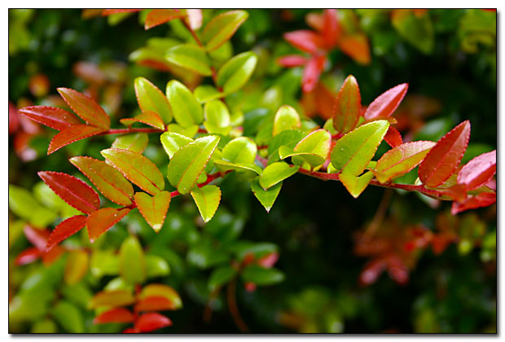
221. Vaccinium ovatum/ Florist’s “Huckleberry”

Slide 18
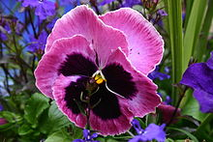
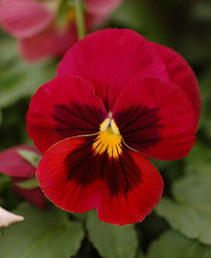
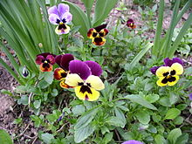
222.Viola x wittrockiana cv./ (Garden) Pansy

Slide 19
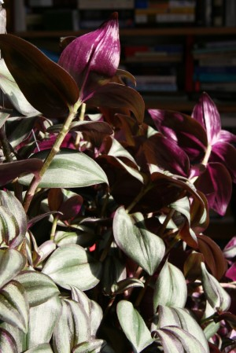
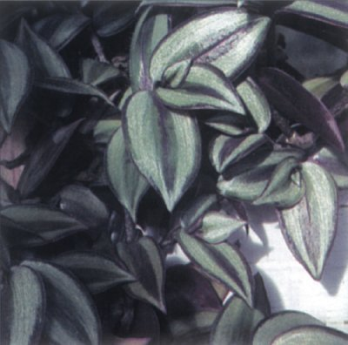
223. Zebrina pendula cv./ Wandering Jew

Slide 20
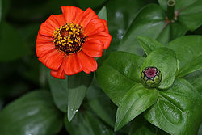
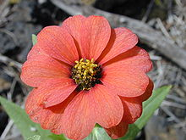
224. Zinnia elegans/ Zinnia

