Slide 1
FFA Floriculture Plant Identification #’s 131 - 156

Slide 2
131. Florist’s Cyclamen (Cyclamen x persicum)

Slide 3
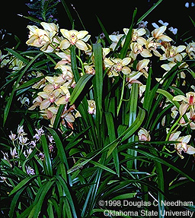
132. Cymbidium cv./cymbidium orchid

Slide 4
133. Carnation (Dianthus xaryophyllus)

Slide 5
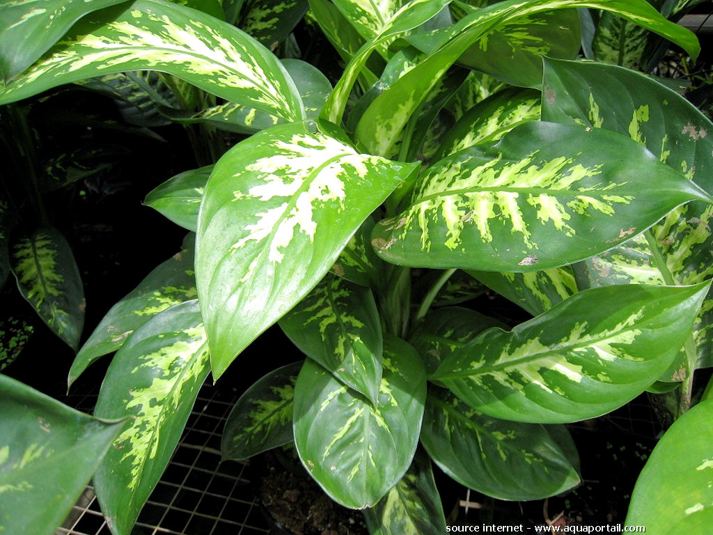
134. Dieffenbachia maculata cv./Spotted Ddumbcane

Slide 6
135. Corn Plant Dracaena (Dracaena fragrans “Massangeana”

Slide 7
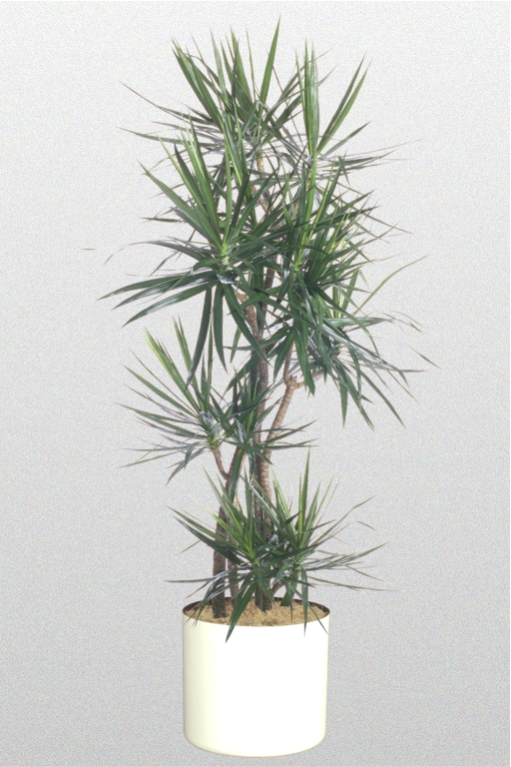
136. Dracaena cincta/Red edge Dracaena

Slide 8
137. Hens and Chickens (Echeveria)

Slide 9
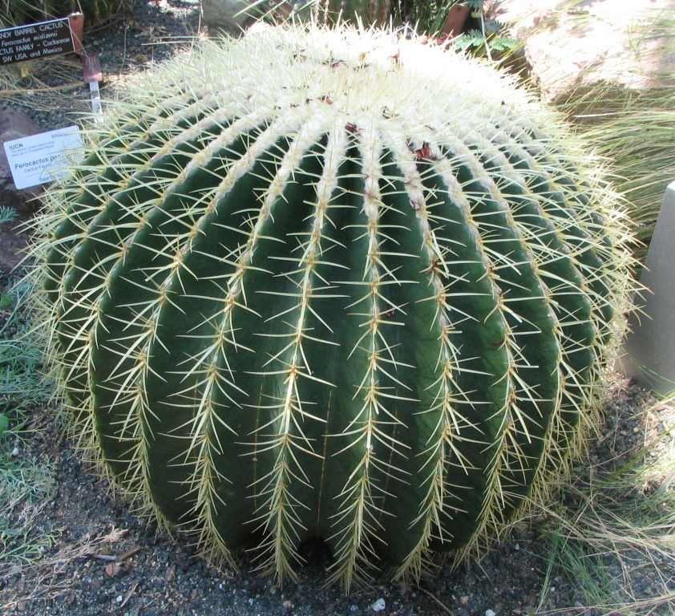
138. Echinocactus cv./barrel cactus

Slide 10
139. Golden Pothos, Devil’s Ivy (Epipremnum aureum)

Slide 11
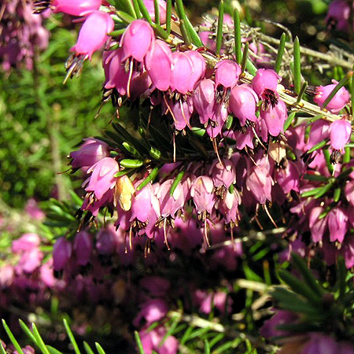
140. Erica carnea cv./spring health

Slide 12
141. Silver Dollar Gum (Eucalyptus polyanthemos)

Slide 13
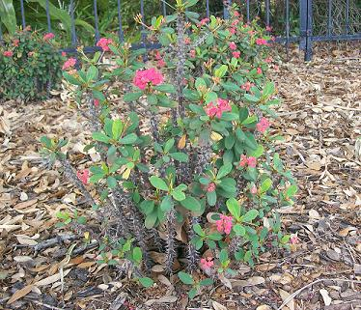
142. Euphorbia milii splenders/Crown- of thorns

Slide 14
143. Poinsettia (Euphorbia pulcherrima)

Slide 15
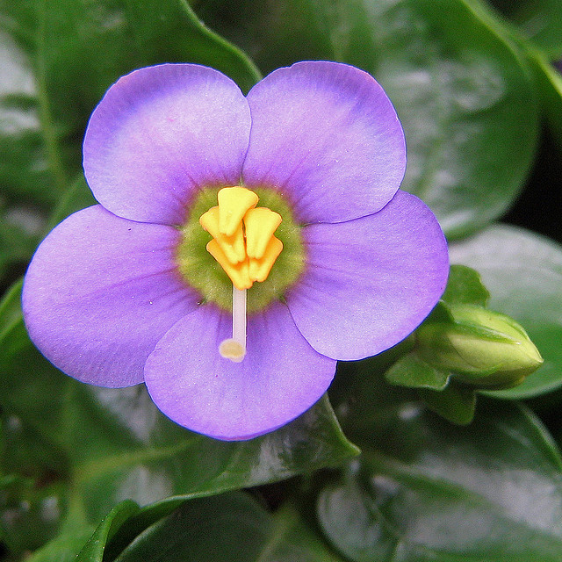
144. Exacum affine/German (Persion)Violet

Slide 16
145. Benjamin Fig (Ficus benjamina ‘Exotica’)

Slide 17
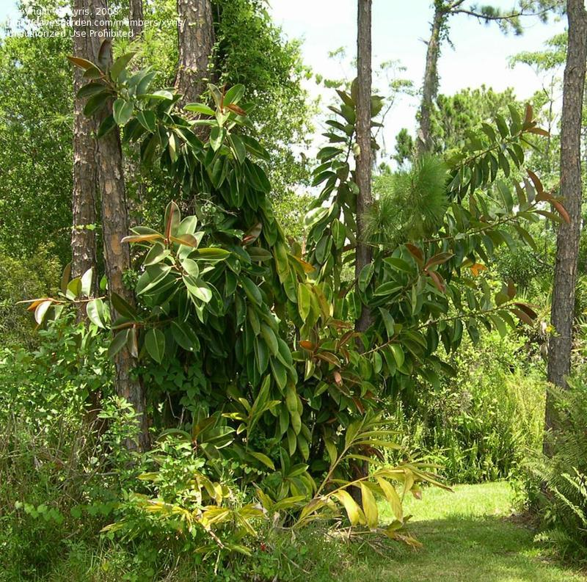
146. Ficus elastica decora/decora rubber plant

Slide 18
147. Creeping Rubber Plant (Ficus pumila)

Slide 19
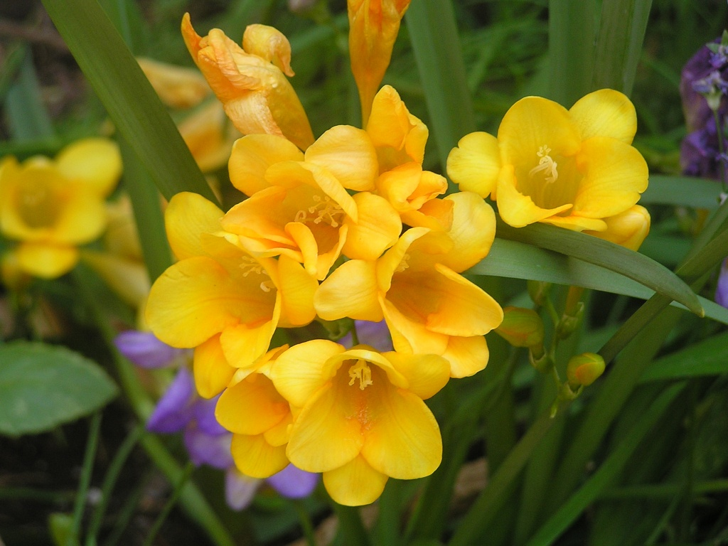
148. Freesia x hybrid/freesia

Slide 20
149. Nerve Plant (Fittonia verschaffeltii)

Slide 21
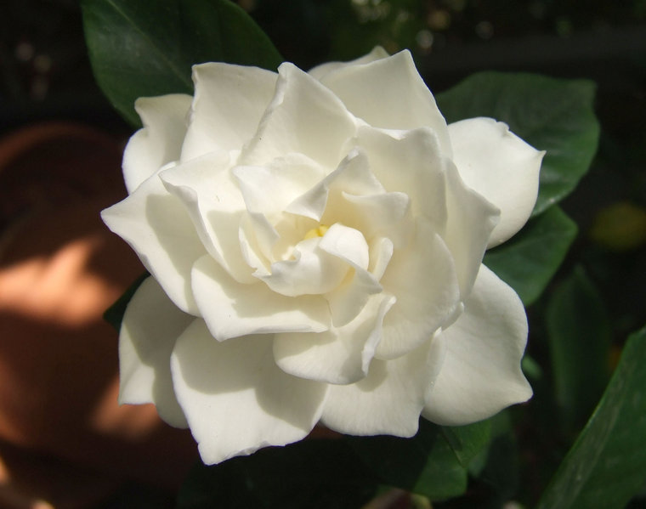
150. Gardenia jasminoides foruniana/gardenia

Slide 22
151. Transvaal Daisy (Gerbera jamesonii)

Slide 23
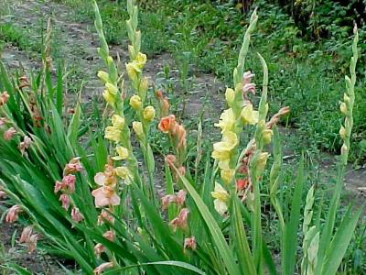
152. Gladious x hortulanus cv./garden gladiolus

Slide 24
153. “Purple Passion,” Velvet Plant (Gynura aurantiaca ‘Sarmentosa’)

Slide 25
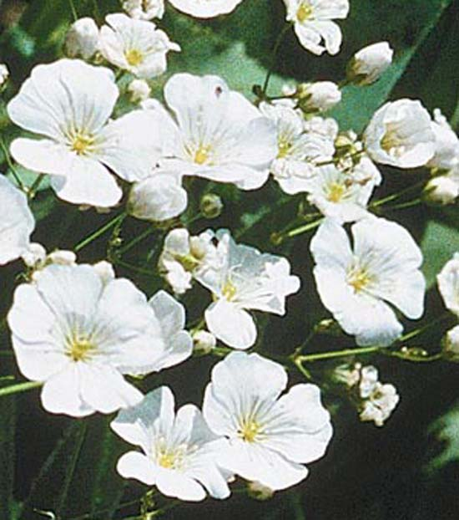
154. Gypsophila elegans cv./baby’s breath

Slide 26
155. English Ivy (Hedera helix)

Slide 27
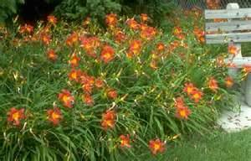
156. Hemerocallis cv./ daylily

