Slide 1
FFA Nursery / Landscape
Plant Identification
(101 – 131)

Slide 2
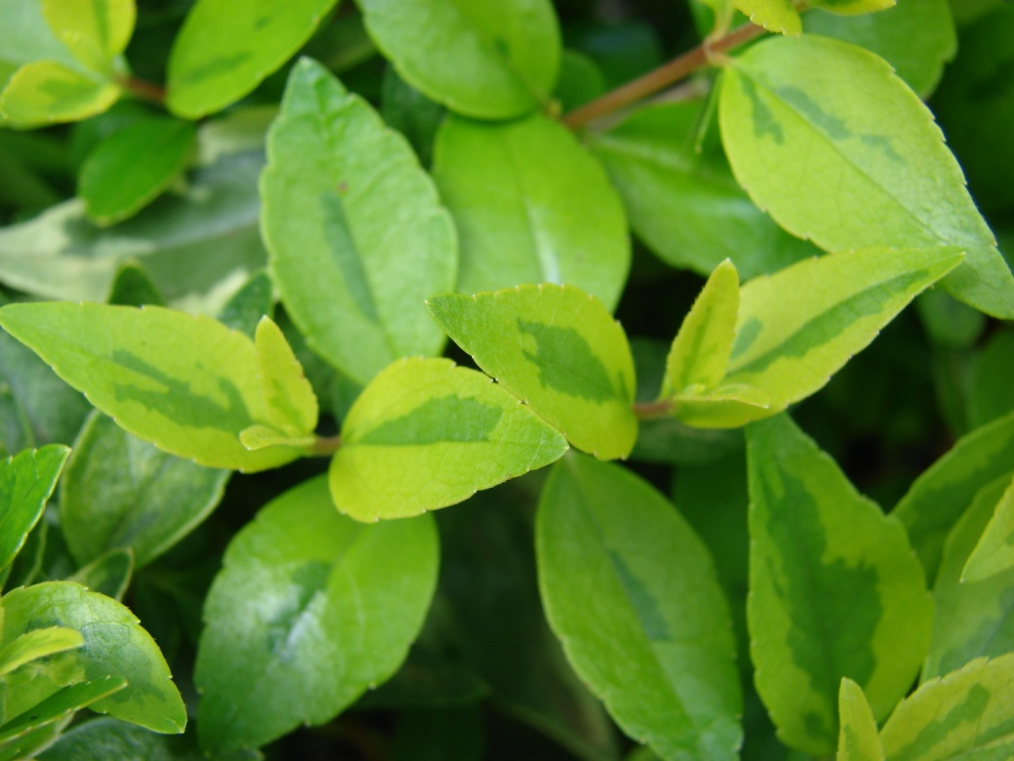
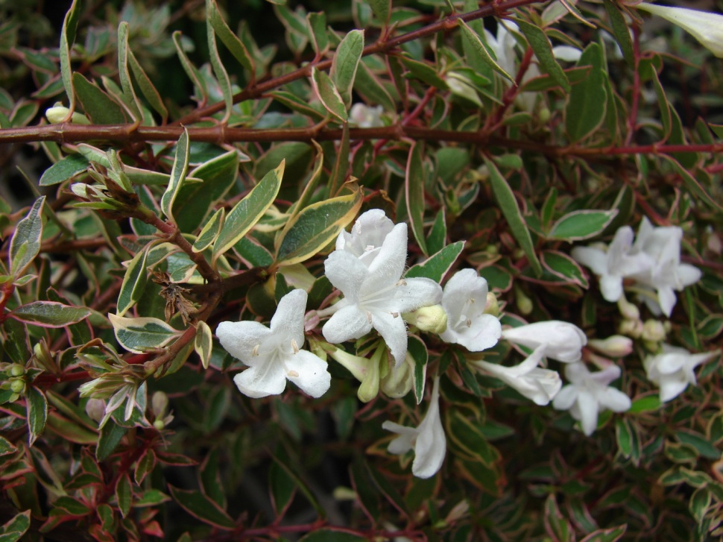
101. Glossy Abelia Abelia x grandiflora

Slide 3
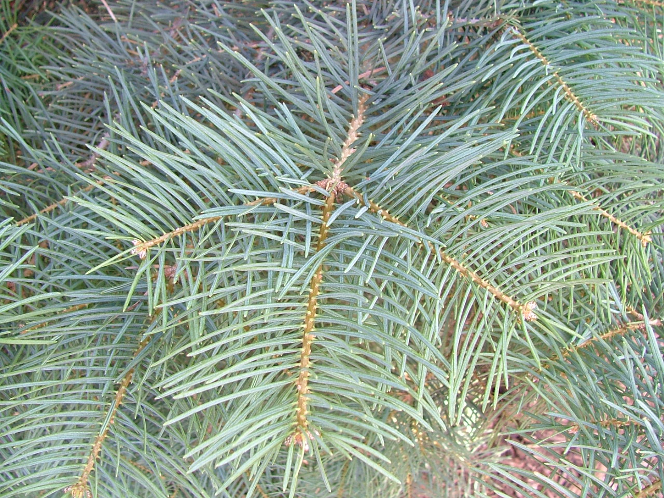
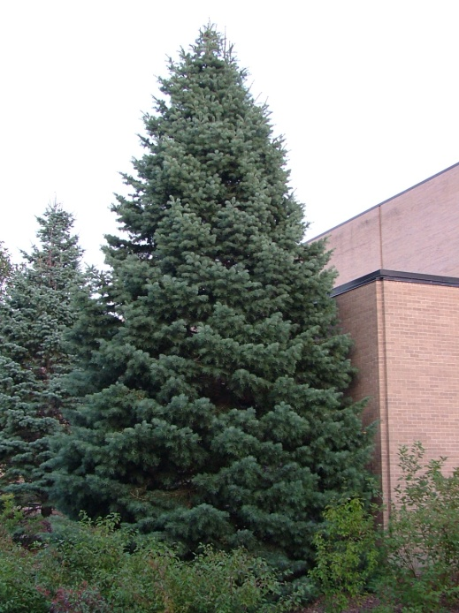
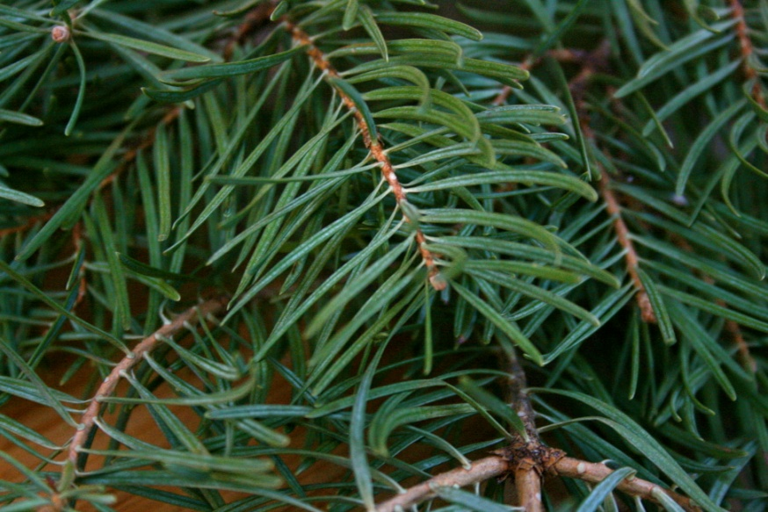
102. White Fir Abies concolor

Slide 4
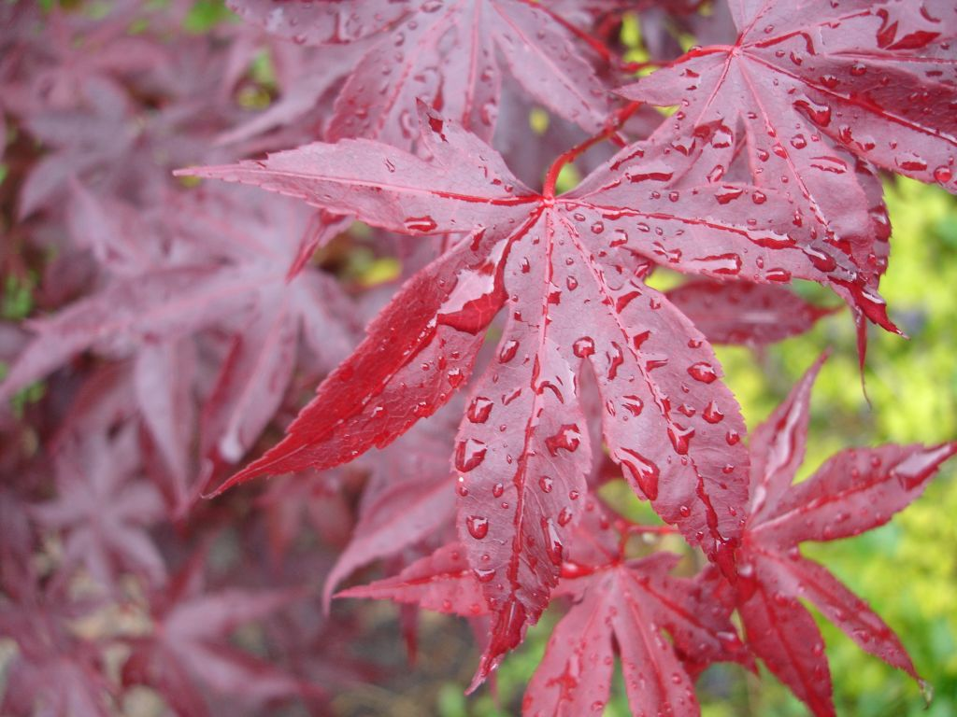
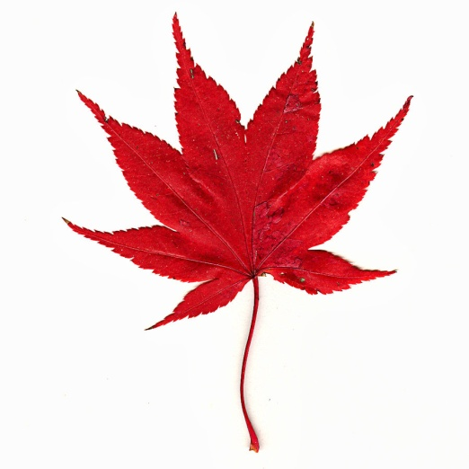
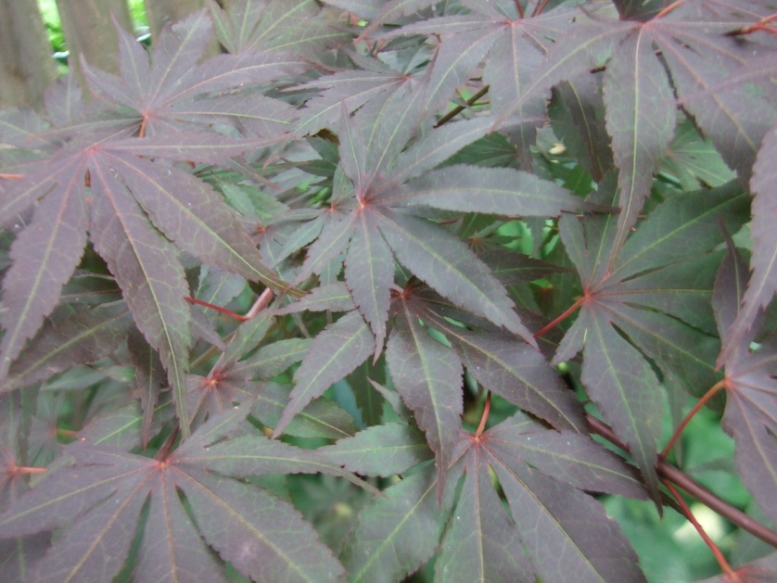
103. Japanese Maple Acer palmatum

Slide 5
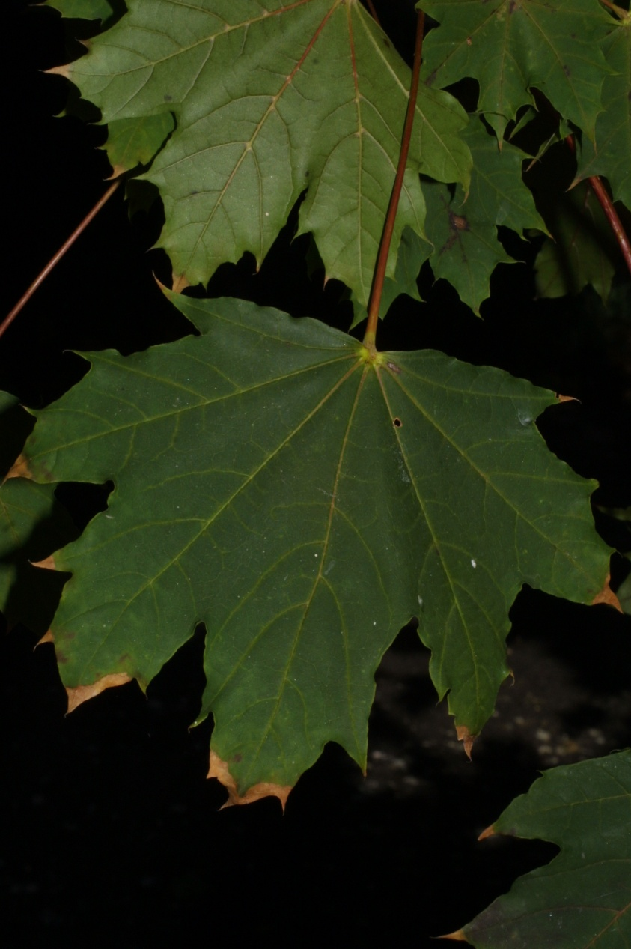
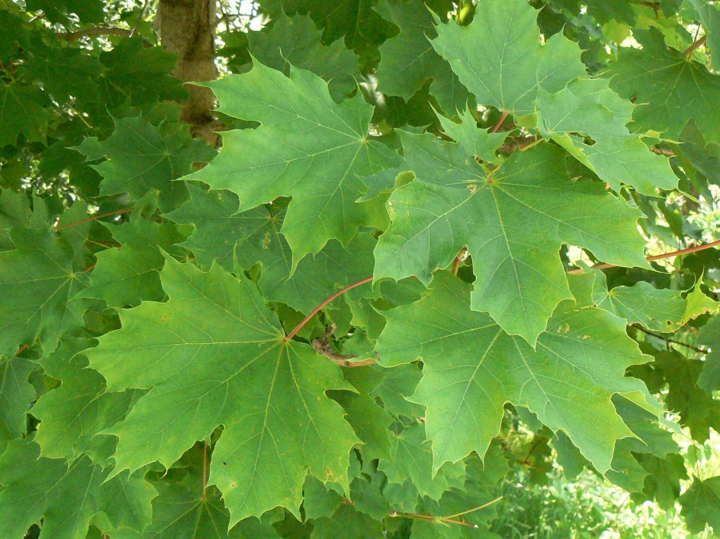
104. Norway Maple Acer platanoides

Slide 6
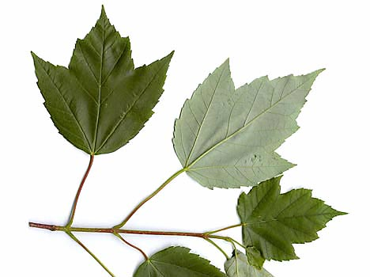
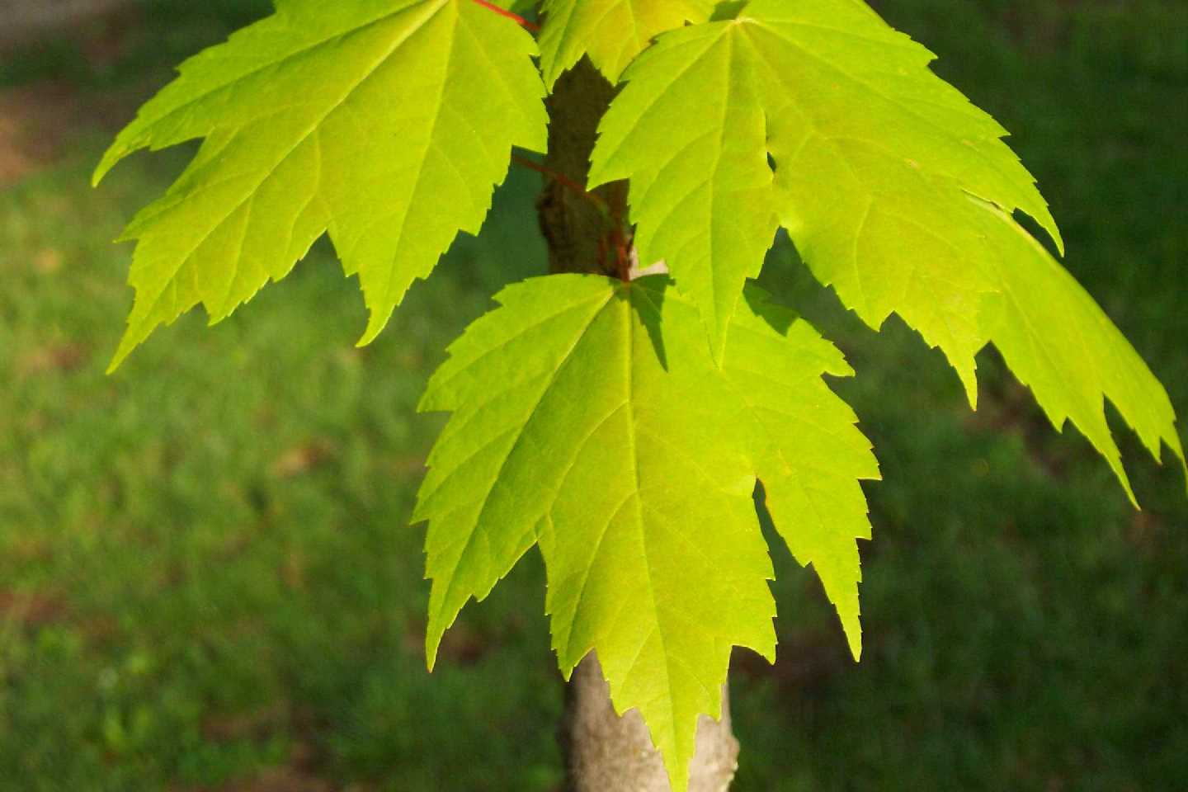
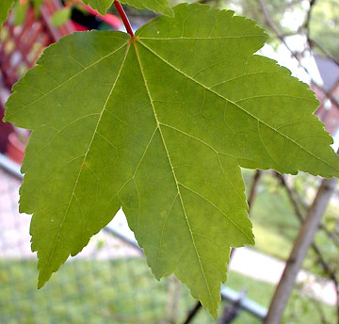
105. Red Maple Acer rubrum

Slide 7
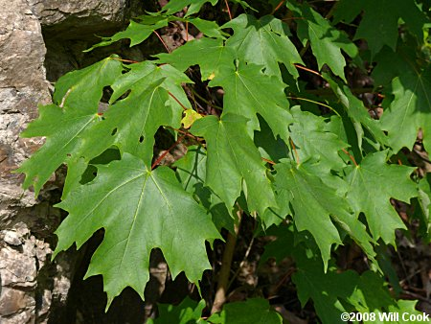
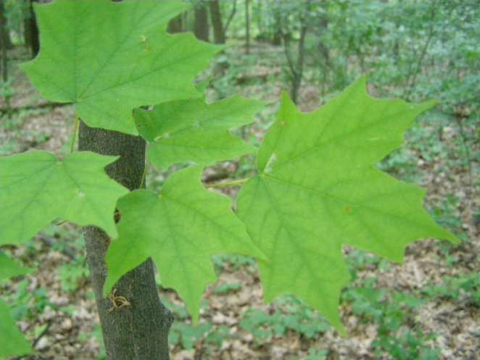
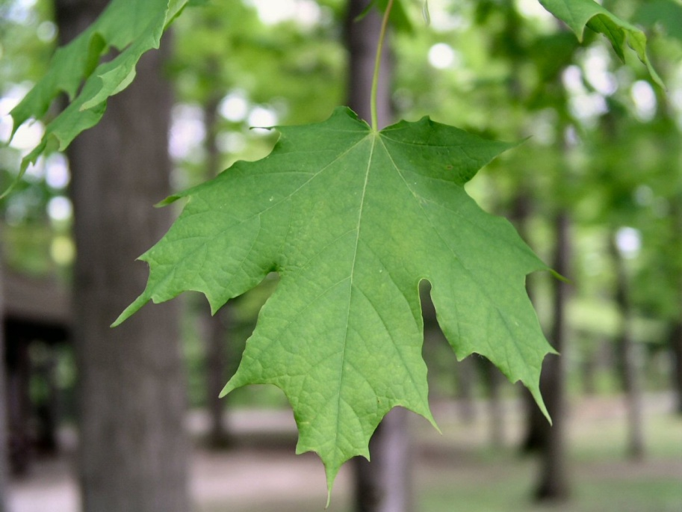
106. Sugar Maple Acer saccharum

Slide 8
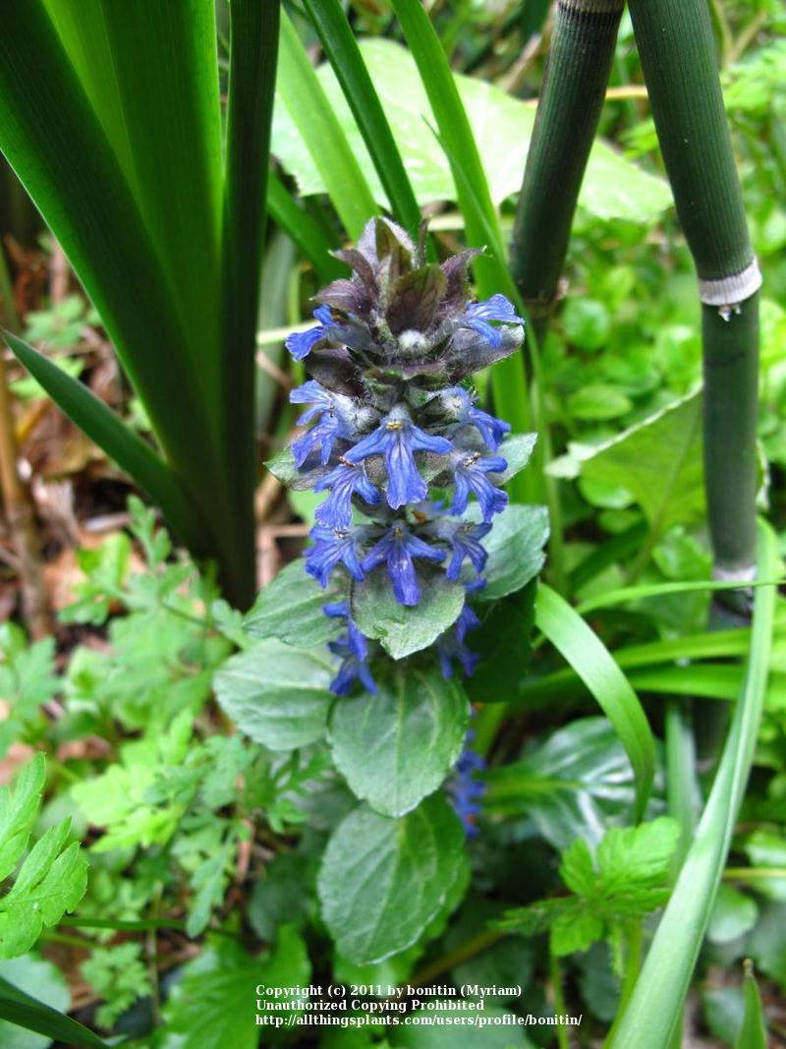
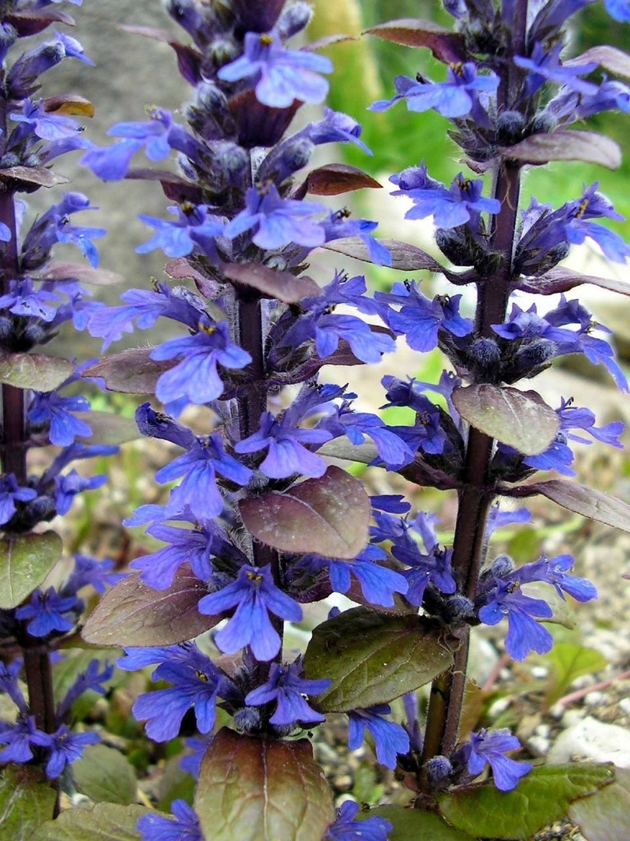
107. Carpet Bugle Ajuga reptans

Slide 9
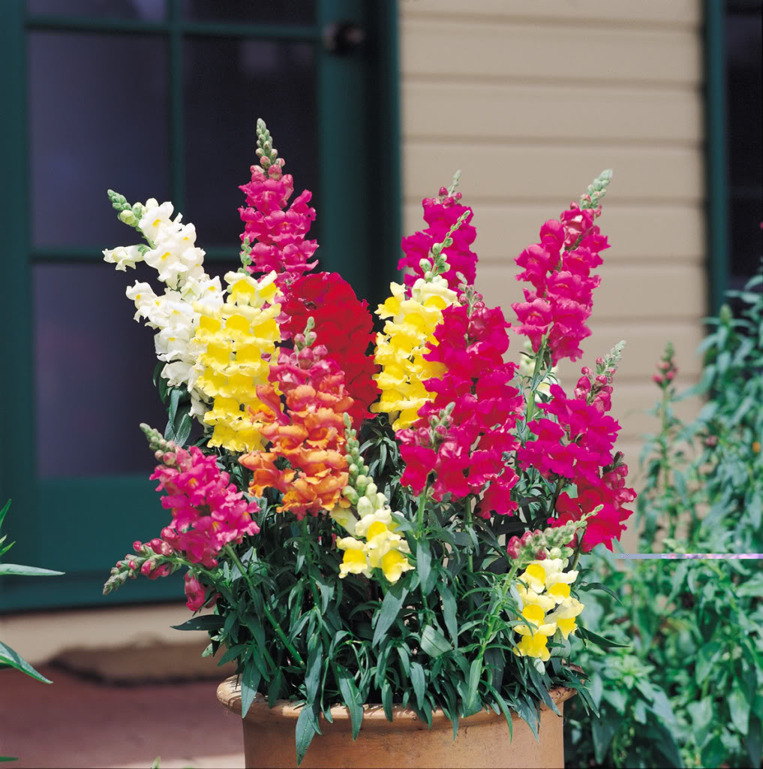
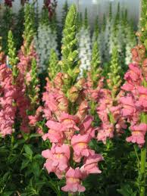
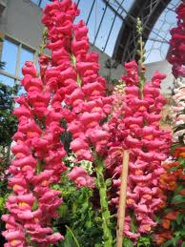
108. Snapdragon Antirrhinum majus

Slide 10
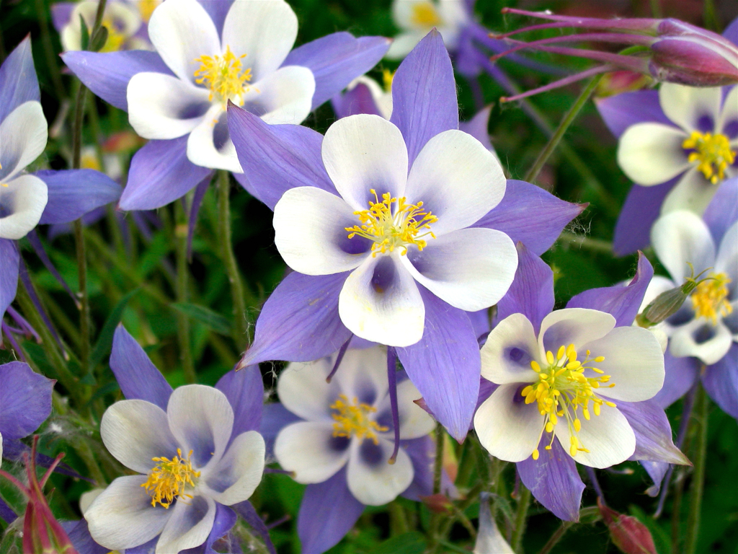
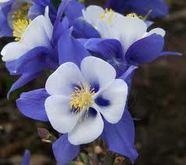
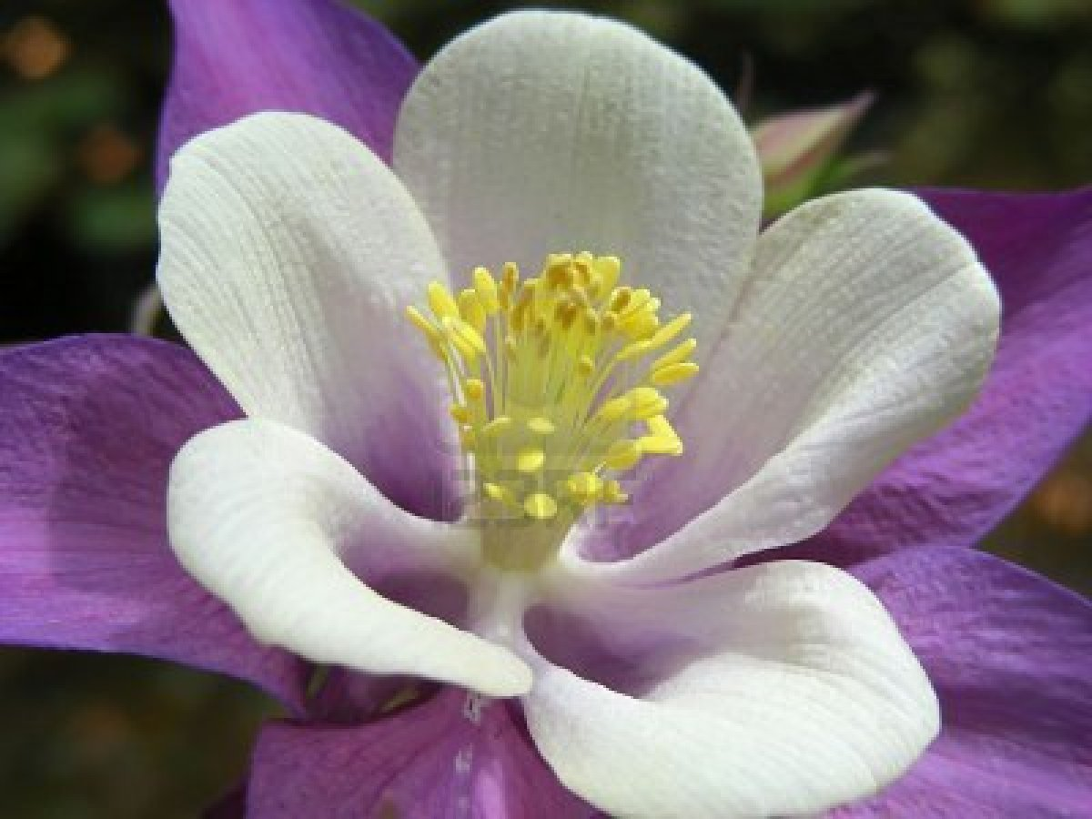
109. Columbine Aquilegia x hybrida

Slide 11
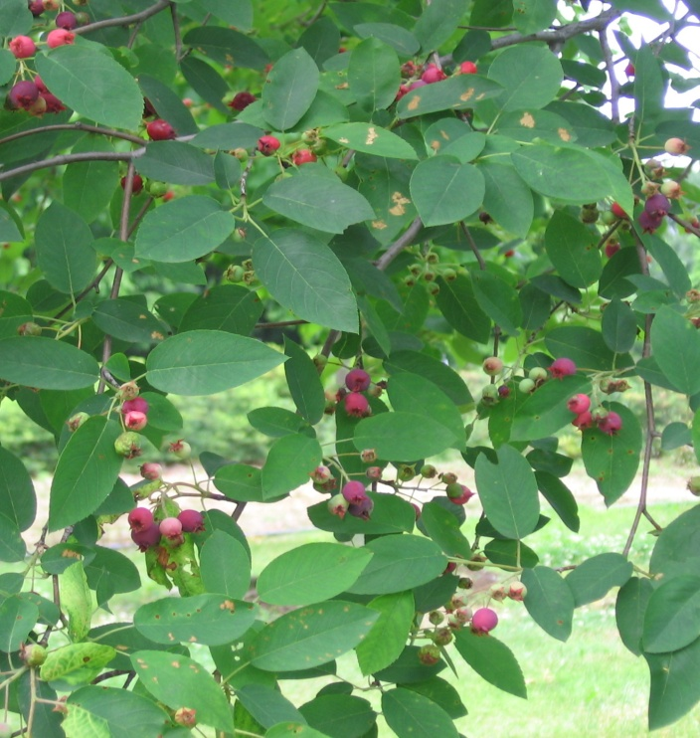
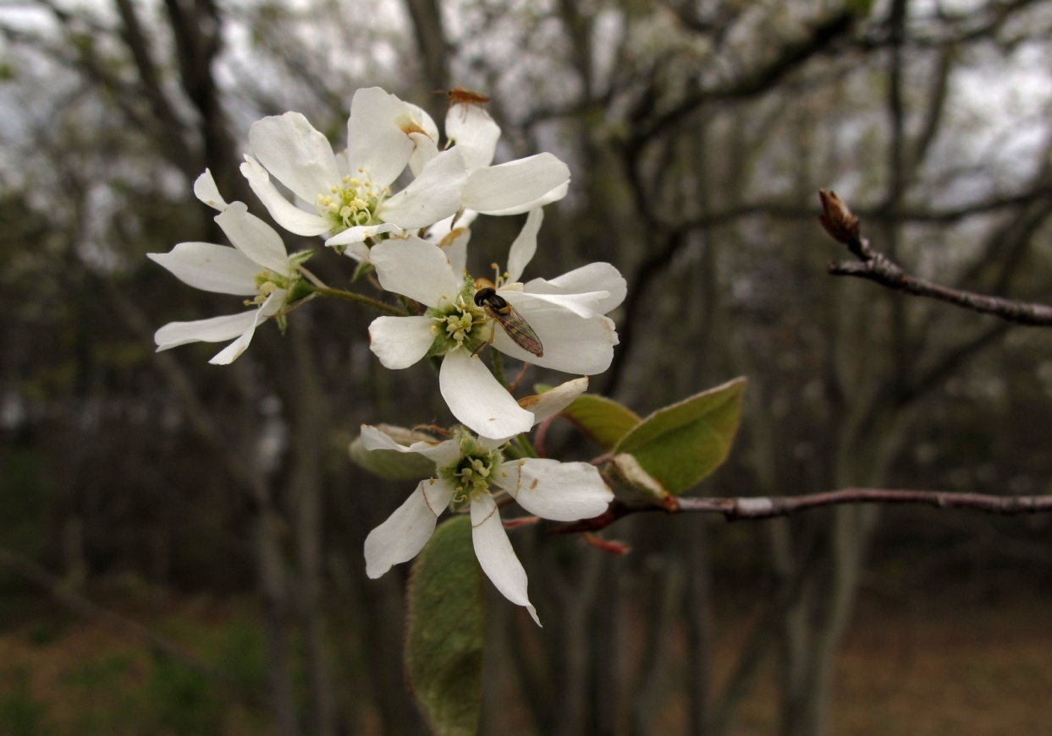
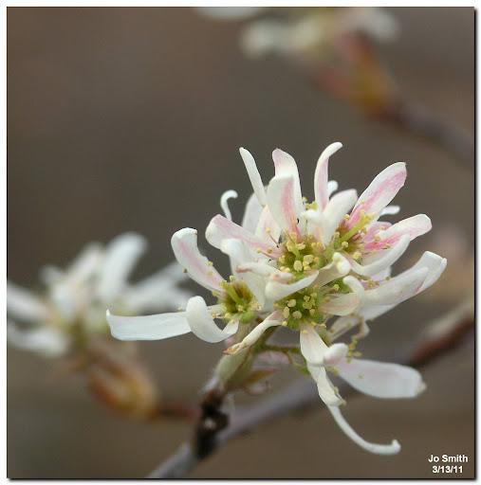
110. Downy Serviceberry Amelanchier arborea

Slide 12
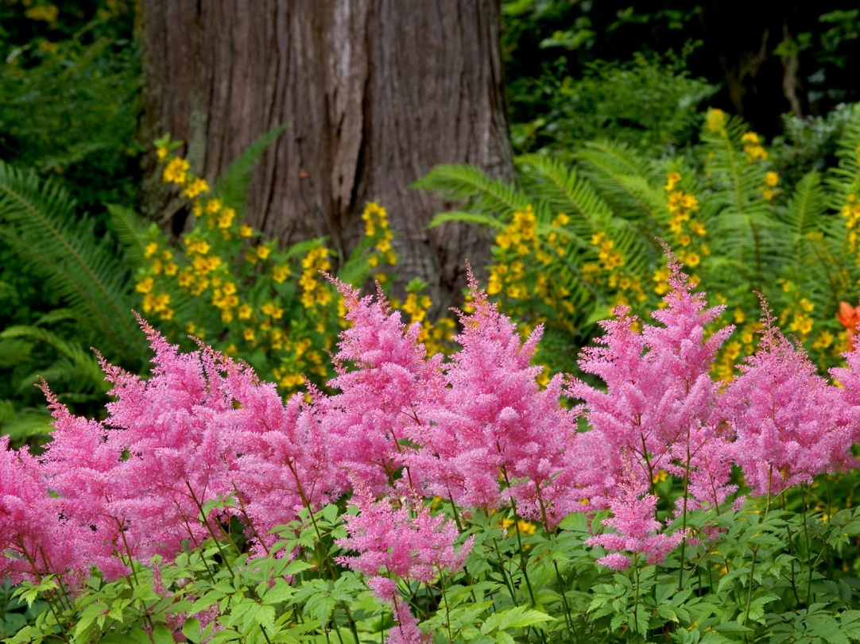
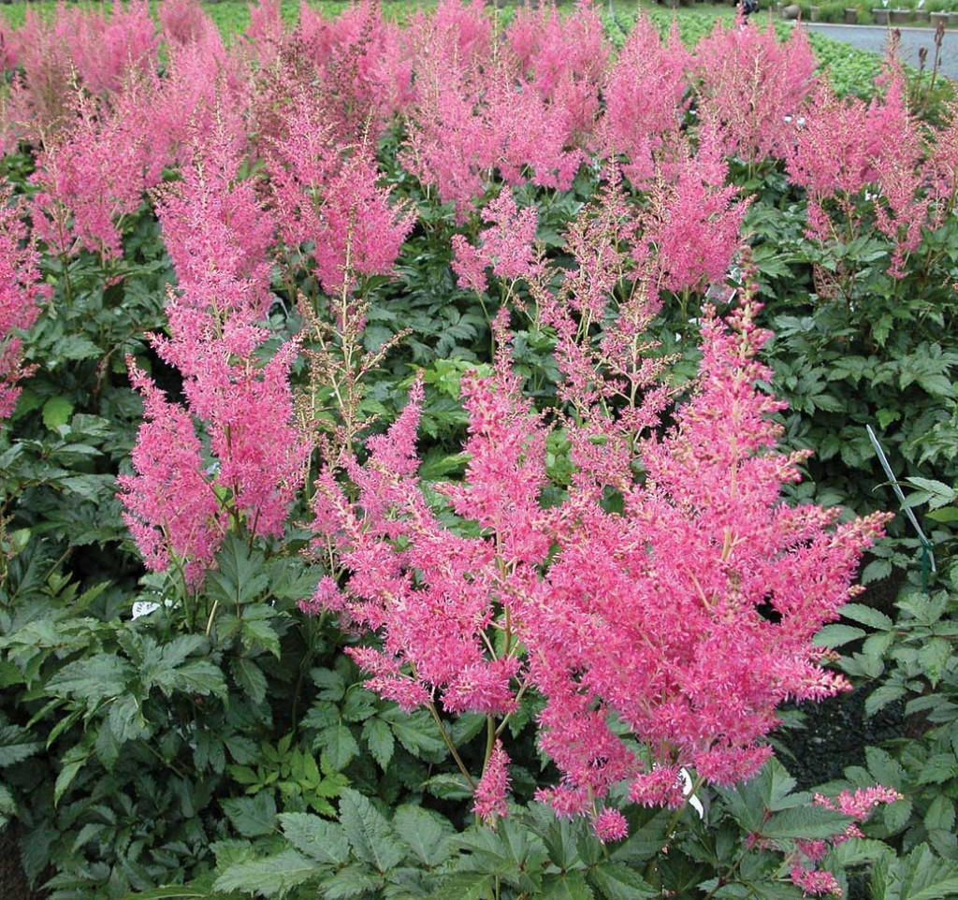
111. Astilbe Astilbe hybrid

Slide 13
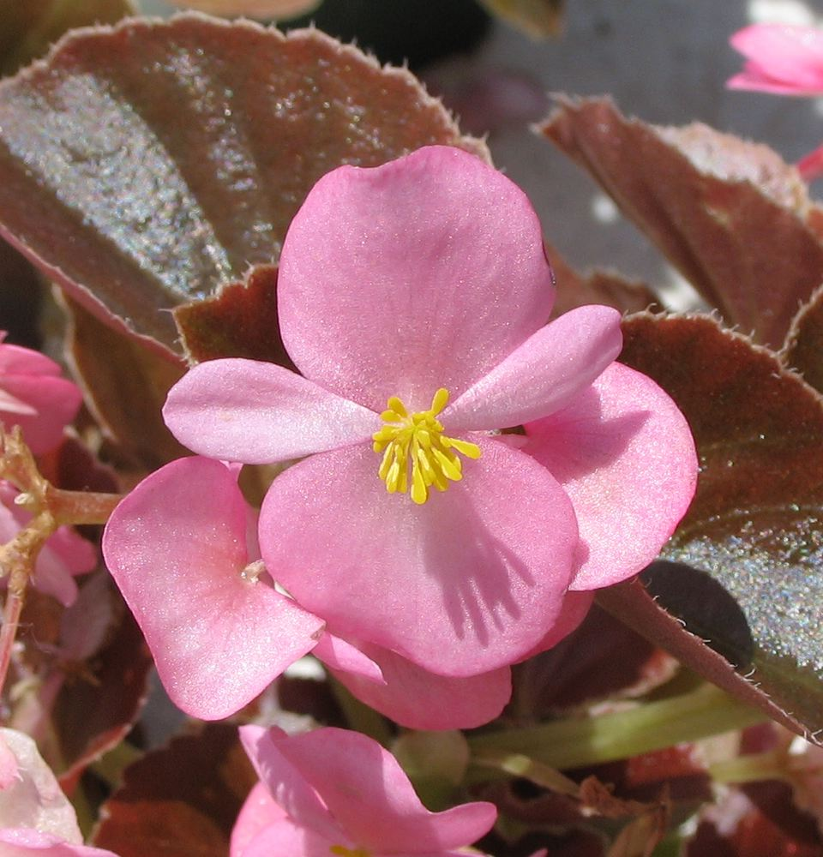
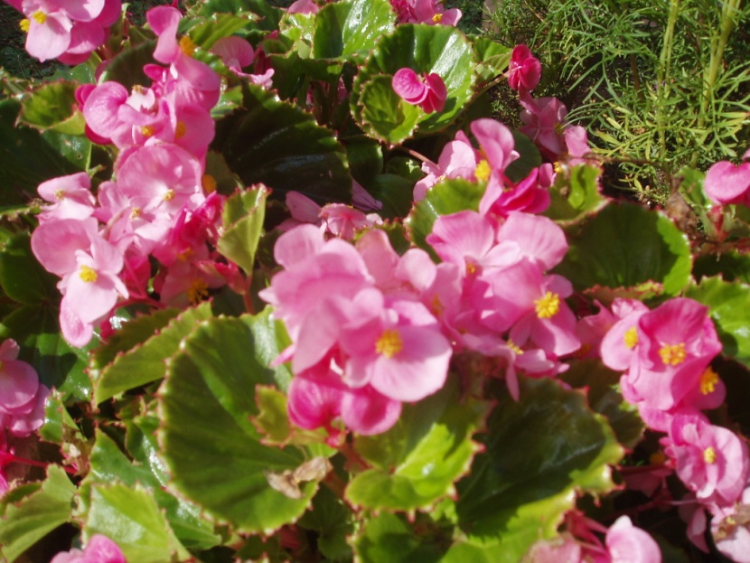
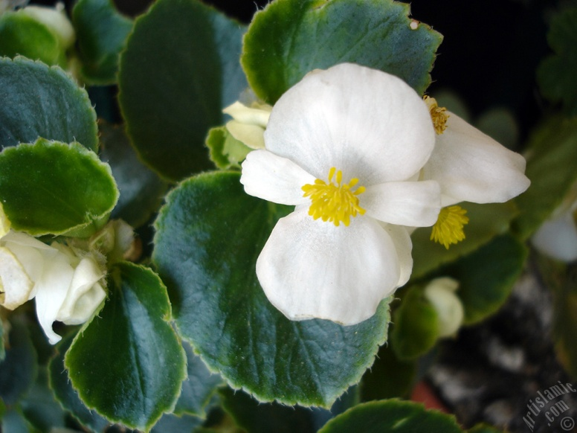
112. Wax Begonia Begonia semperflorens-cultorum

Slide 14
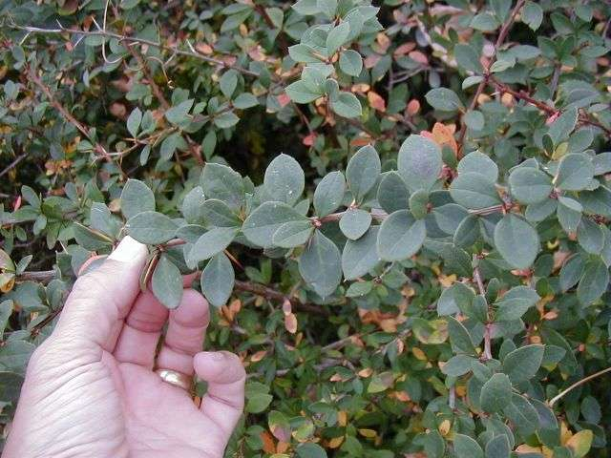
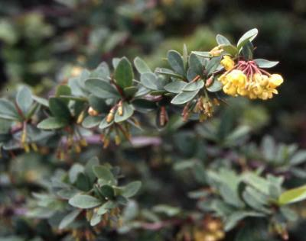
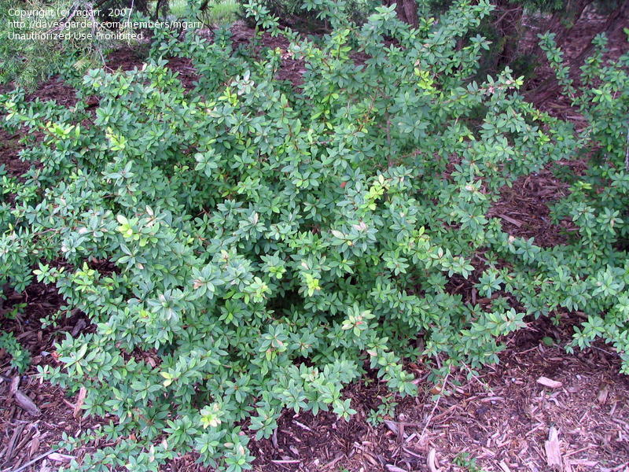
113. Mentor Barberry Berberis x mentorensis

Slide 15
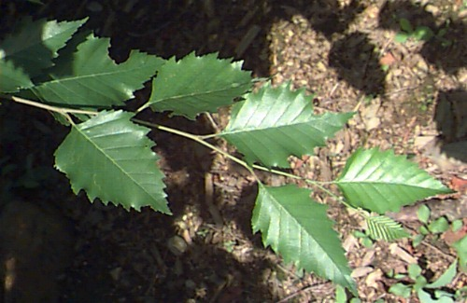
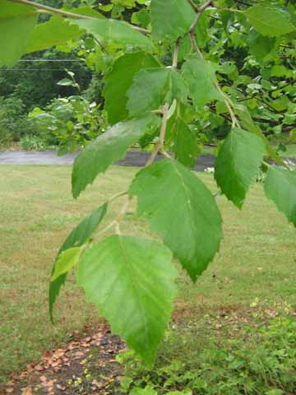
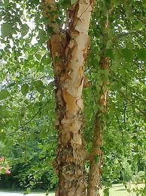
114. River Birch Betula nigra

Slide 16
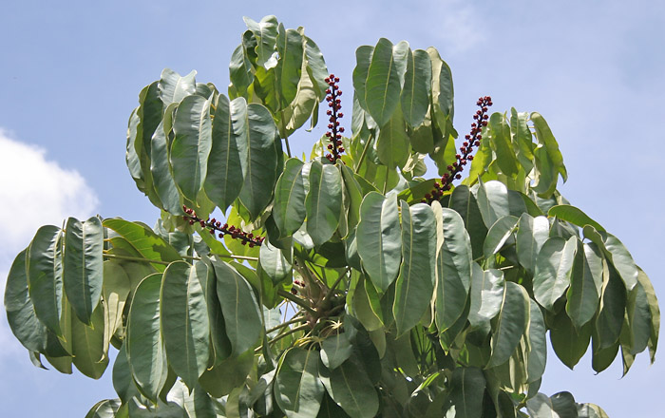
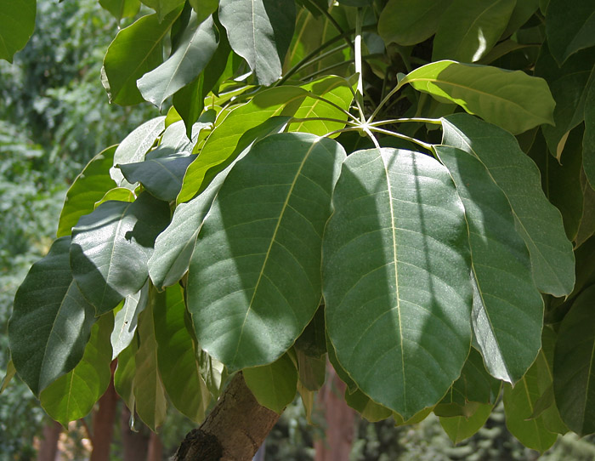
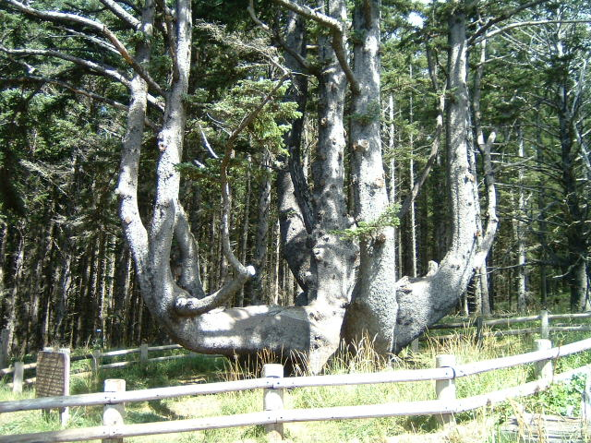
115. Scheffler (Octopus Tree) Brassaia actinophylla

Slide 17
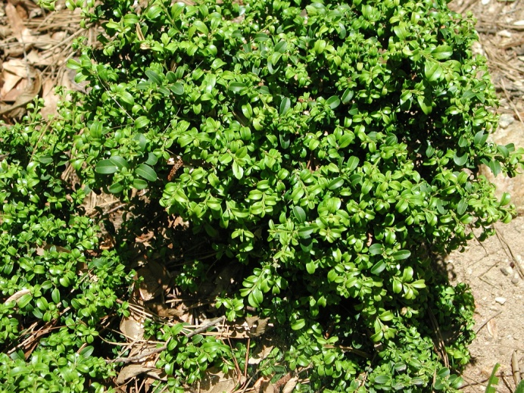
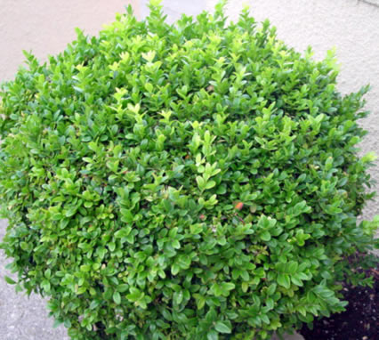
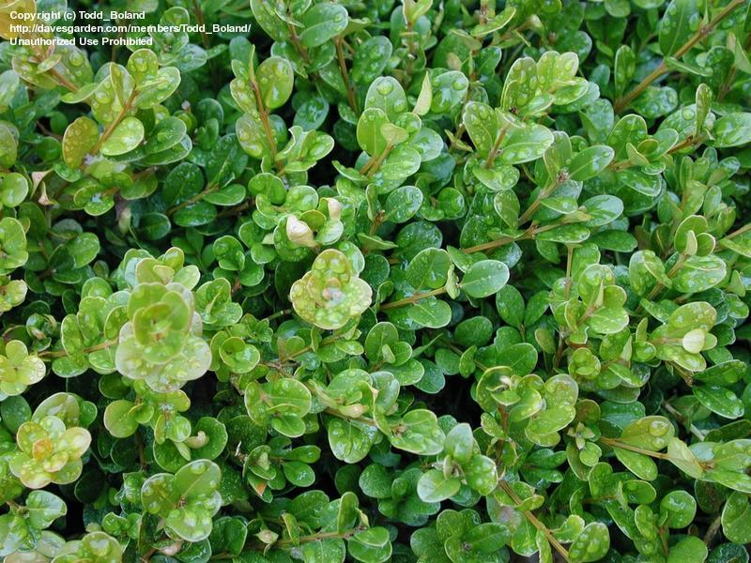
116. Littleleaf Boxwood Buxus microphylla

Slide 18
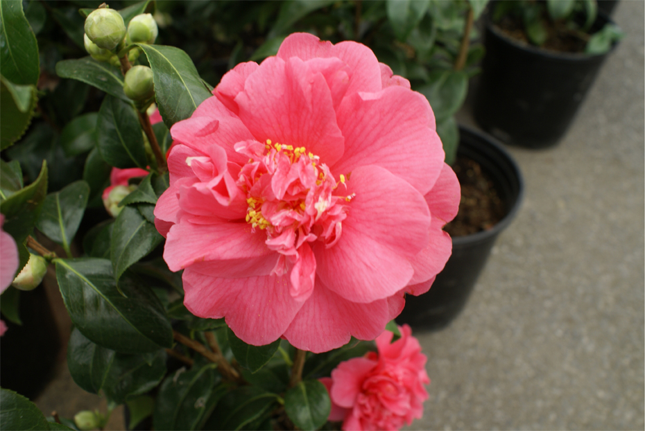
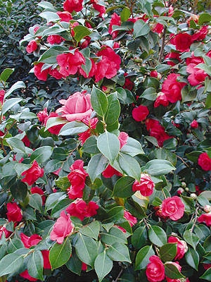
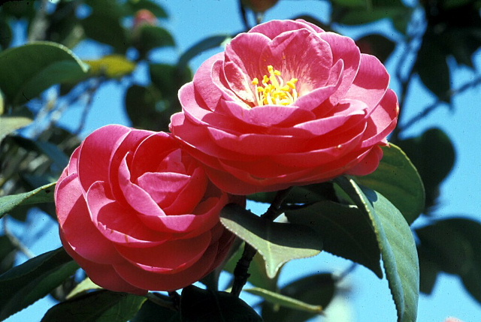
117. Common Camellia Camellia japonica

Slide 19
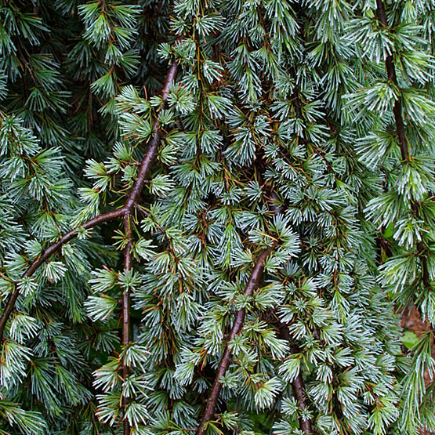
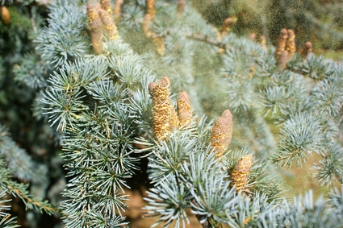
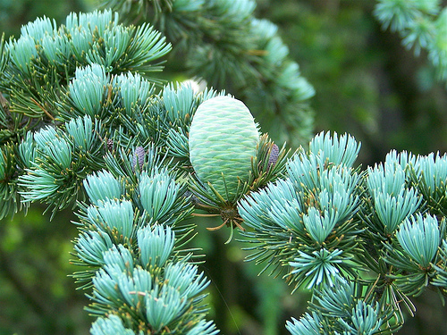
118. Glauca / Blue Atlas Cedar Cedrus atlantica

Slide 20
119. Redbud Cercis canadensis

Slide 21
120. Japanese Flowering Quince Chaenomeles speciosa

Slide 22
121. Shasta Daisy Chrysanthemum x superbum

Slide 23
122. Flowering Dogwood Cornus florida

Slide 24
123. Bearberry Cotoneaster Cotoneaster dammeri

Slide 25
124. Spreading Cotoneaster Cotoneaster divaricatus

Slide 26
125. Washington Hawthorn Crataegus phaenopyrum

Slide 27
126. Bermudagrass Cynodon dactylon

Slide 28
127. Spotted Dumb Cane Dieffenbachia maculata

Slide 29
128. Warneckii / Striped Dracaena Dracaena deremensis

Slide 30
129. Massangeana / Corn Plant Draceana fragens

Slide 31
130. Purple Coneflower Echinecea purpurea

Slide 32
131. Pothos Epipremnum spp.

