Slide 1
FFA Floriculture Plant I.D.
#’s 157 – 181 PART I

Slide 2
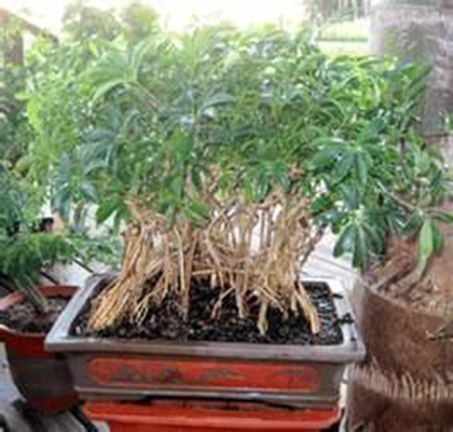
157. Heptaplleurum arboricola/dwarf schefflera, dwarf octopus tree

Slide 3
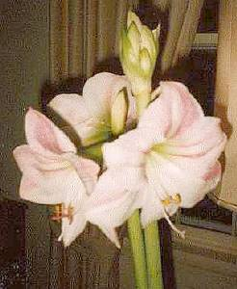
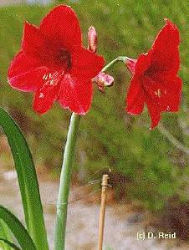
158. Hippeastrum hybrid cv./Amaryllis

Slide 4
159. Hosta undulata/ plantain lily

Slide 5
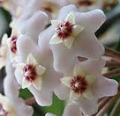
160. Hoya carnosa/ Wax Plant

Slide 6
161. Hyacinthus orimtalis cv./ hyacinth

Slide 7
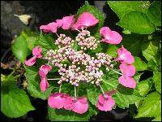
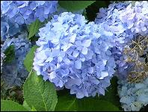
162. Hydrangea macrophylla cv. / French (Florist’s) Hydrangea

Slide 8
163. Impathiens hybrid cv.

Slide 9
164. Flag (Bearded) Iris (Iris x germanicaflorentina)

Slide 10
165. Iris x xiphium cv./ dutch

Slide 11
166. Shrimp Plant (Justicia brandegeana)

Slide 12
167. Kalanchoe x blossfeldiana cv./ Kalanchoe

Slide 13
168. Shasta Daisy (Leucanthemum x superbum)

Slide 14
169. Liatris spicata/ liatris

Slide 15
170. Trumpet (Easter) Lily (Lilium longiflorum)

Slide 16
171. Lilum x hybridum cv./ Hybrid (garden) lily

Slide 17
172. Statice (Limonium sinuatum)

Slide 18
173. Lobularia maritima / sweet alyssum

Slide 19
174. Prayer Plant (Maranta leuconeura var. kerchoviana)

Slide 20
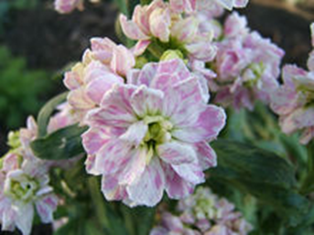
175. Matthiola incana cv./ Flowering Stock

Slide 21
176. Cutleaf “Philodendron” (Monstera deliciosa)

Slide 22
177. Narcissus Pseudonarcissus cv./ Daffodil

Slide 23
178. Bromeliad (‘Tricolor’ Neoregelia carolinae)

Slide 24
179. Nephrolepis exaltata cv./ Boston Fern

Slide 25
180. Cactus (Opuntia tribe)

Slide 26
181. Paeonia cv./ Peony

Slide 27
182. Ladyslipper Orchid (Paphiopedilum x hybrid)

Slide 28
PART II #’s 183-205

Slide 29
183. Pelargonium x domesticum / regal Geranium

Slide 30
184. (Zonal) Geranium (Pelargonium x hortorum)

Slide 31
185. Pelargonium peltatum / Ivy Geranium

Slide 32
186. Watermelon Peperomia (Peperomia argyreia)

Slide 33
187. Peperomia caperata / Emerald Ripple Peperomia

Slide 34
188. Variegated Peperomia (Peperomia obtusifolia)

Slide 35
189. Petunia x hybrida / Common Garden Petunia

Slide 36
190. Phalaenopsis (Butterfly) Orchid (Phalaenopsis)

Slide 37
191. Philodendron scandens oxycardium / Heartleaf Philodendron

Slide 38
192. Aluminum Plant (Pilea cadierei)

Slide 39
193. Pilea involucrata / Friendship Plant

Slide 40
194. Artillery Plant (pilea microphylla)

Slide 41
195. Pilea nummularifolia / Creeping Charley

Slide 42
196. Swedish Ivy (Plectranthus mummularis)

Slide 43
197. Polianthes tuberosa / Tuberose

Slide 44
198. Polyanthus (primrose) (Primula x polyanthus)

Slide 45
199. Primula malacoides / Fairy Primrose

Slide 46
200. Azalea (Rhododendron)

Slide 47
201. Rosa hybrid, Class Hybrid Tea / Hybrid Tea Rose

Slide 48
202. Leatherleaf Fern (Rumohra adiantiformis)

Slide 49
203. Saintpaulia ionantha / African Violet

Slide 50
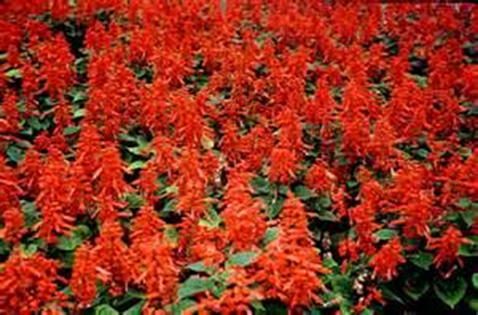
204. Salvia (Salvia splendens)

Slide 51
205. Sansevieria trifasciata / Snake Plant

