Slide 1
FFA Floriculture Plant I.D.
Set # 1 (101 – 130)

Slide 2
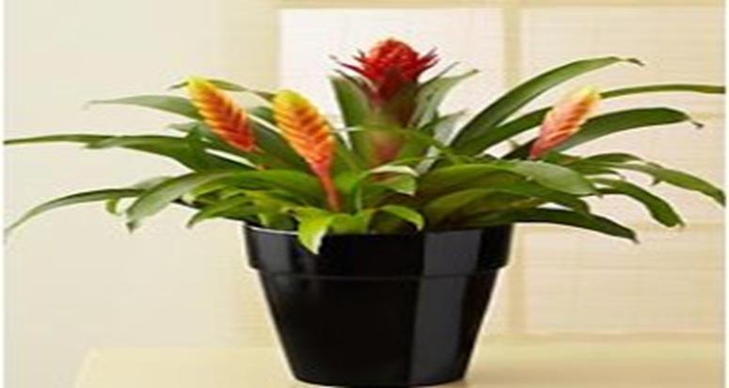
101. Bromeliad (Aechmea Chatinii)

Slide 3
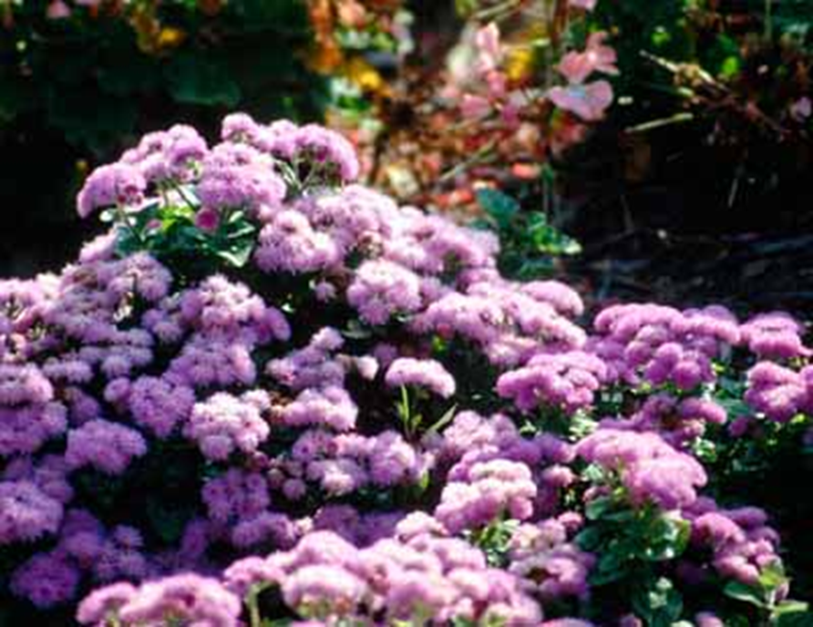
102. Ageratum (Ageratum mexicanum)

Slide 4
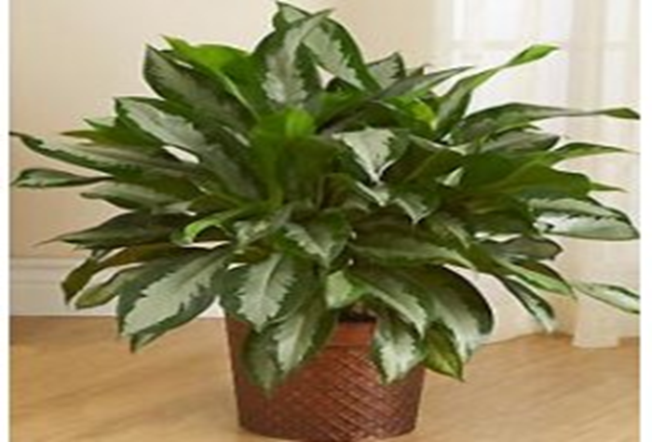
103. Aglaonema (Alganomena Commutatum)

Slide 5
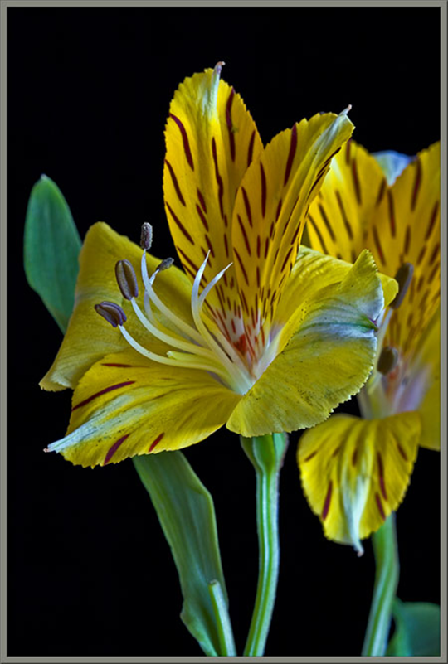
104. Peruvian Lily (Alstroemeria aurantiaca)

Slide 6
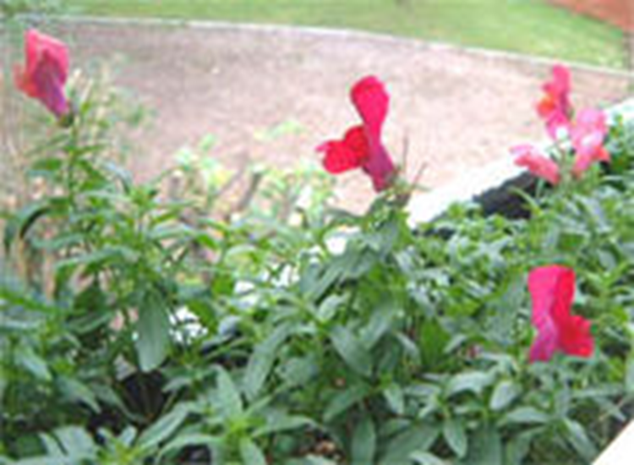
105. Snapdragon (Antrirrihnum majus)

Slide 7
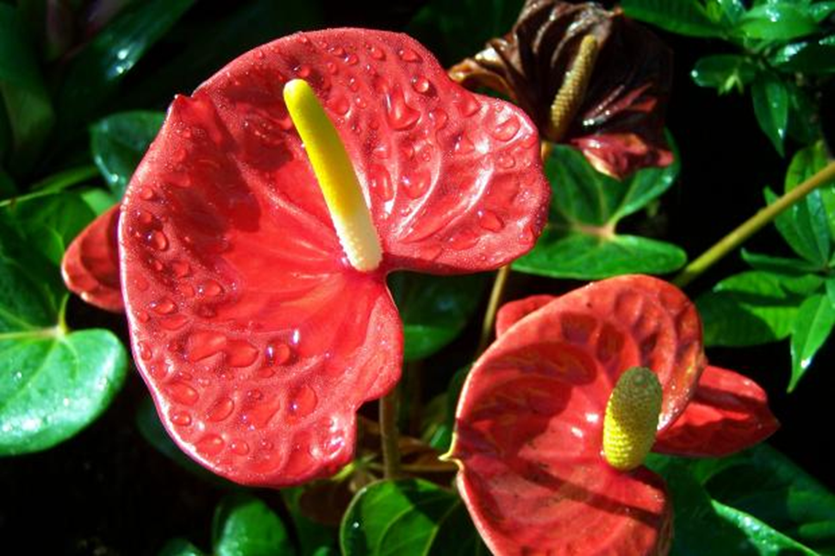
106. Flamingo Lily (Anthurium x andraenum)

Slide 8
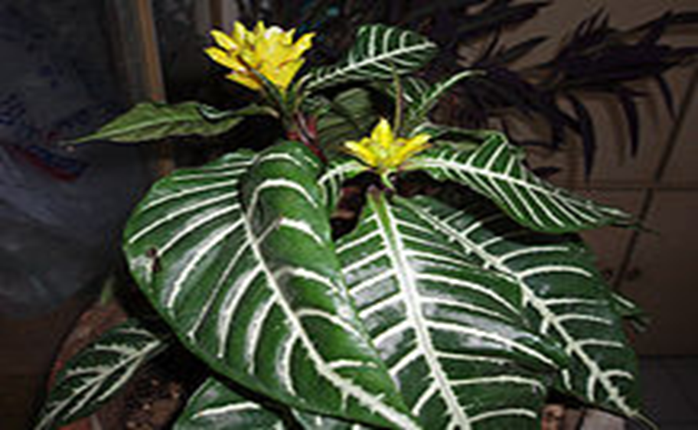
107. Aphelandra, Zebra (Aphelandra squarrosa)

Slide 9
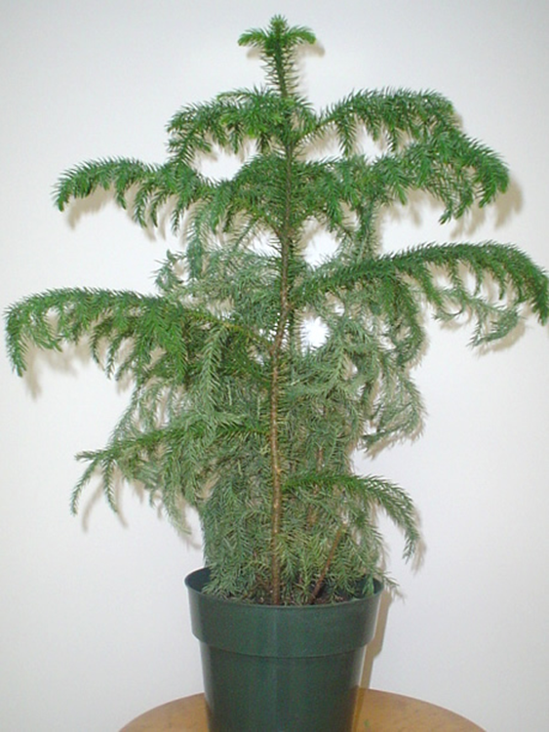
108. Norfolk Island Pine (Araucaria heteropyhlla)

Slide 10
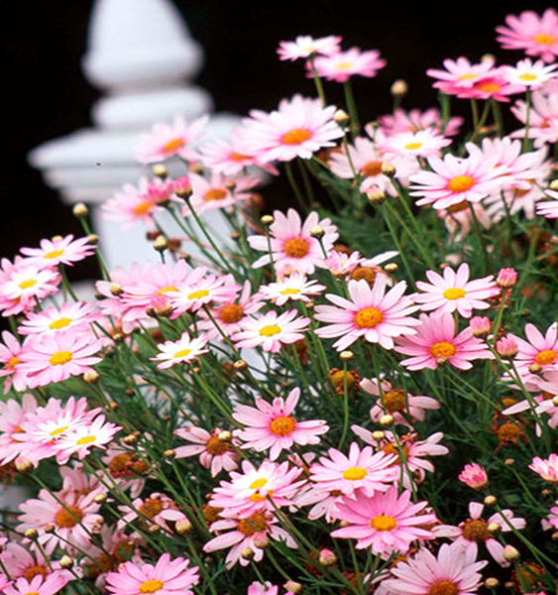
109. Marguerite Daisy (Argyranthemum frutescens)

Slide 11
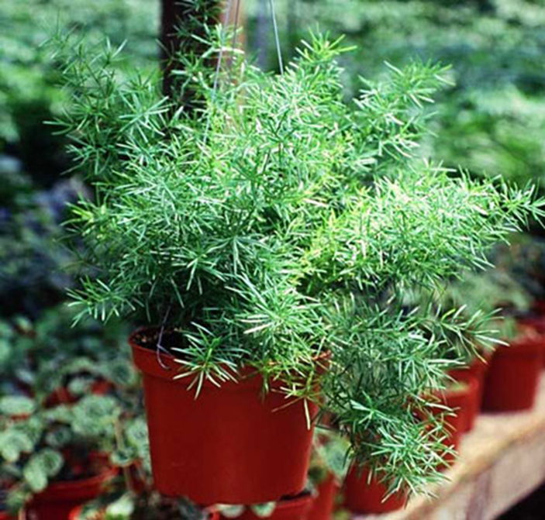
110. Sprengeri “Fern’’ (Asparagus densiflorus)

Slide 12
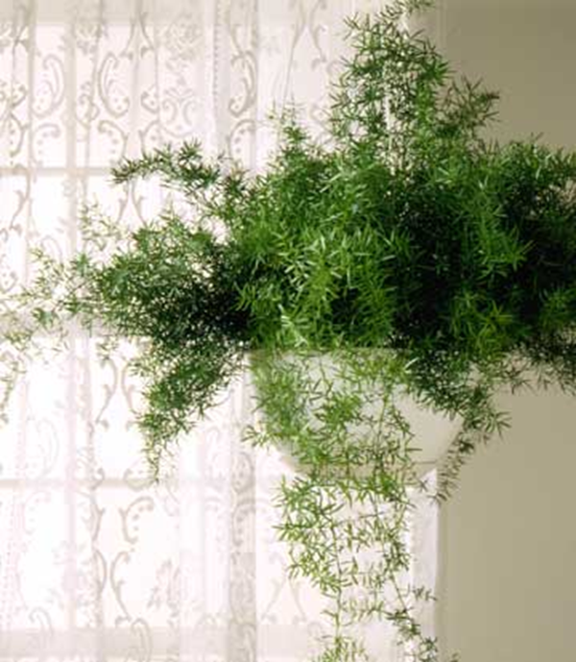
111. Asparagus Fern (Asparagus setaceus)

Slide 13
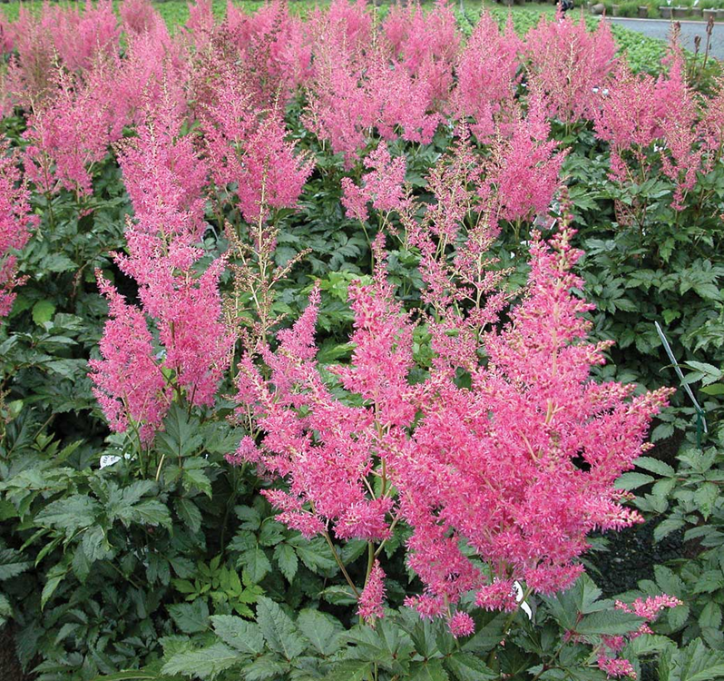
112. Astible (Astible hybrid cv.)

Slide 14
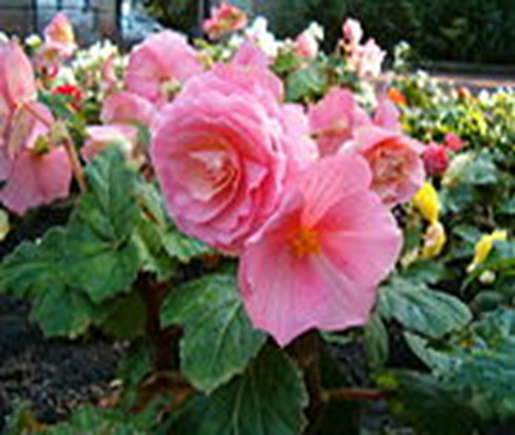
113. Tuberous Begonia (Begonia x tuberhybrida)

Slide 15
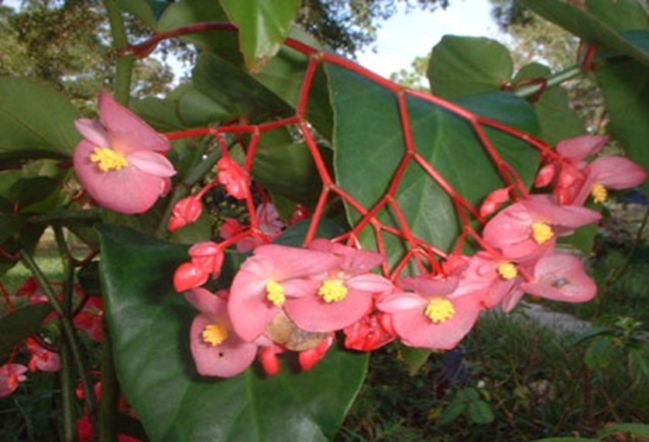
114. Wax Begonia (Begonia x semperflorens- cultorum)

Slide 16
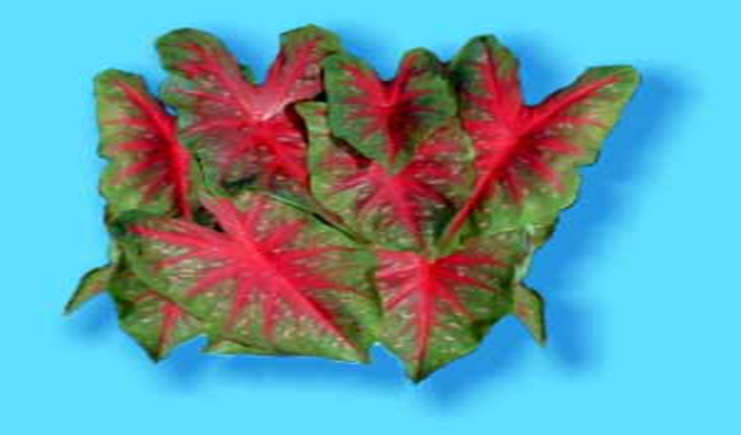
115. Fancy-Leaved Caladium (Caladium x hortulanum)

Slide 17
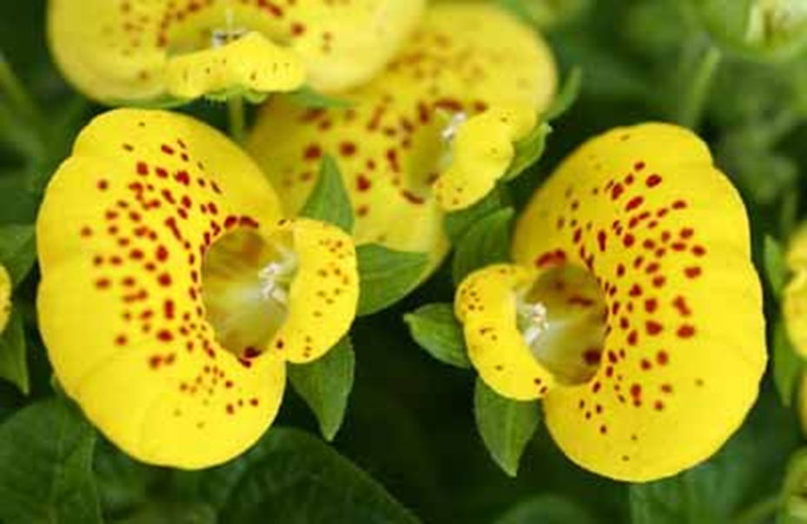
116. Pocketbook Plant (Calceolaria crenatiflora cv.)

Slide 18
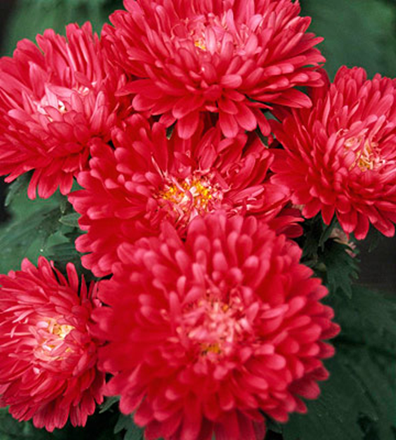
117. China Aster (Callistephus chinensis)

Slide 19
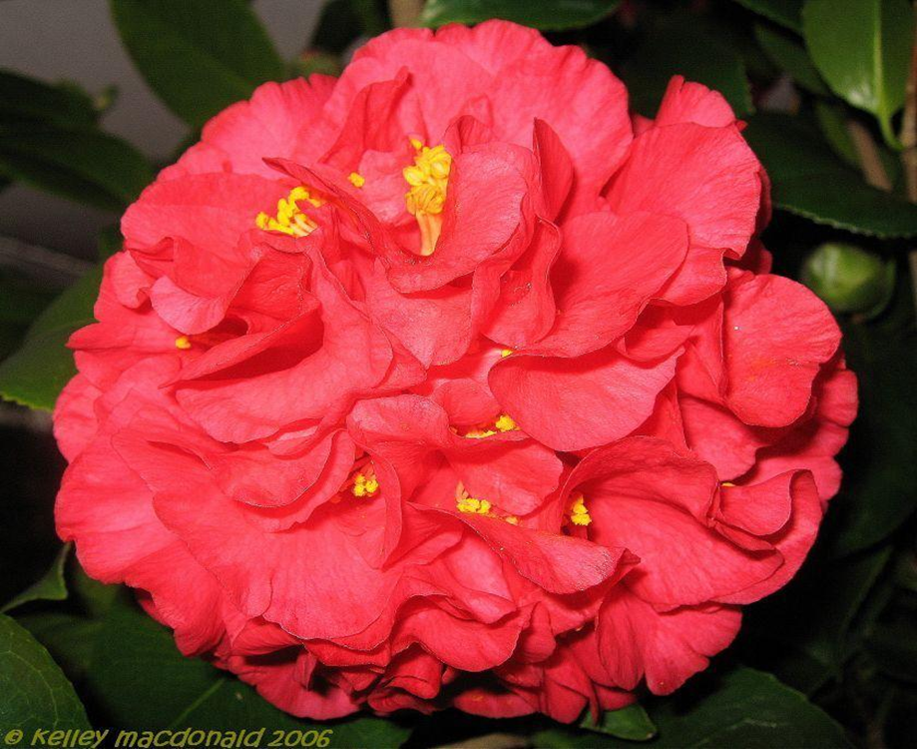
118. Common Camellia (Camellia japonica cv.)

Slide 20
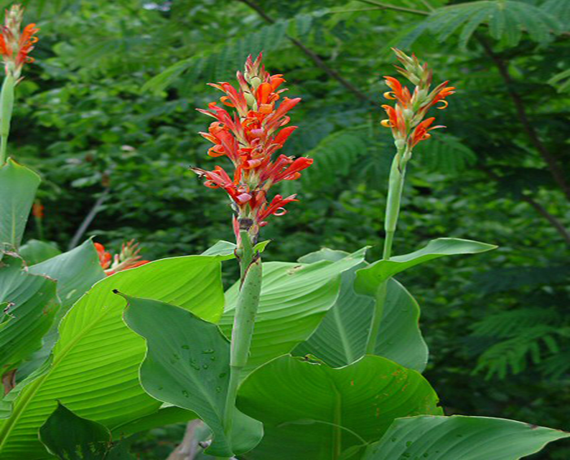
119. Common Garden Canna (Canna x generalis)

Slide 21
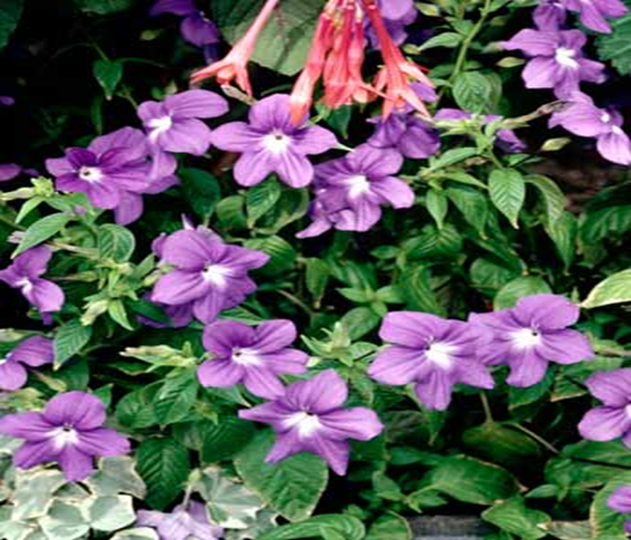
120. Periwinkle (Catharanthus roseus)

Slide 22
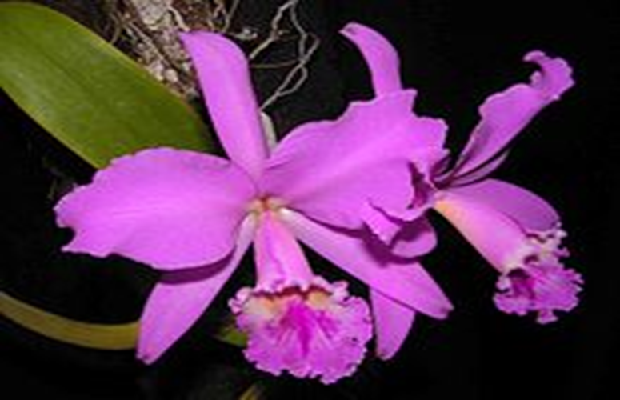
121. Cattleya Orchid Hybrid (Cattleya)

Slide 23
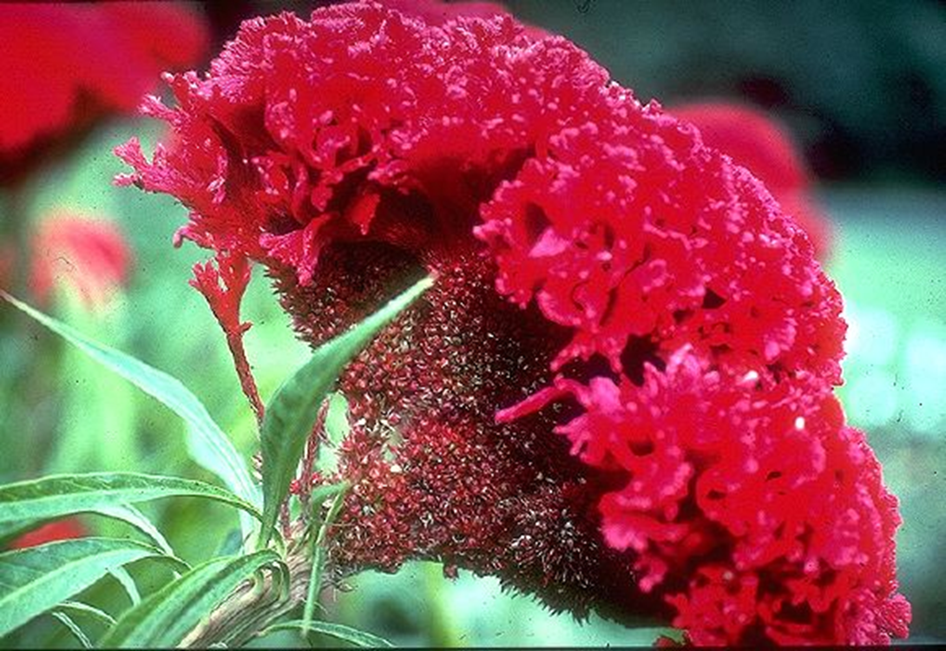
122. Cockscomb (Celosia argentea)

Slide 24
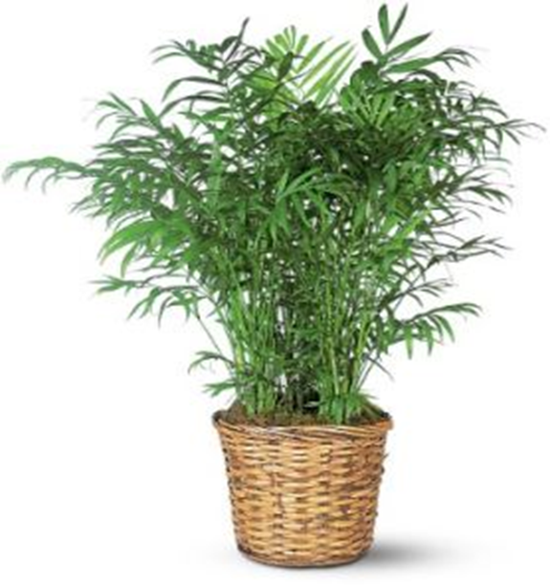
123. Parlor Palm (Chamaedorea elegans)

Slide 25
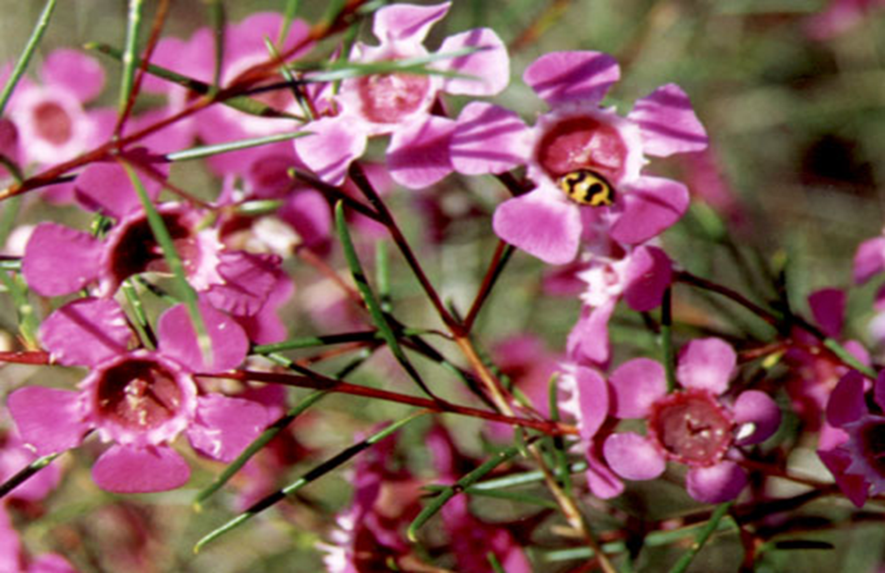
124. Waxflower (Chamelucium uncinatum)

Slide 26
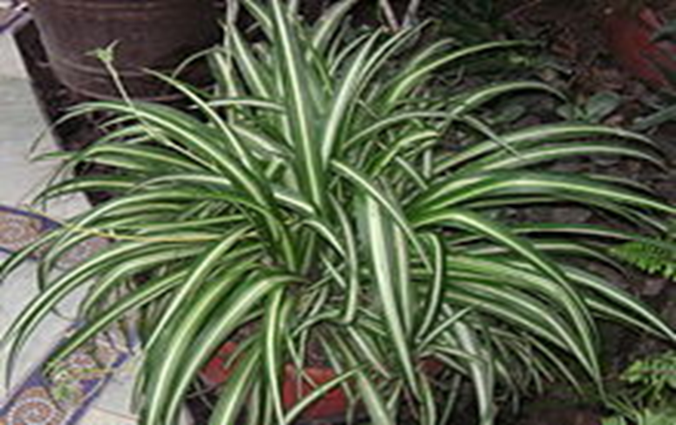
125. Spider Plant (Cholorophytum comosum)

Slide 27
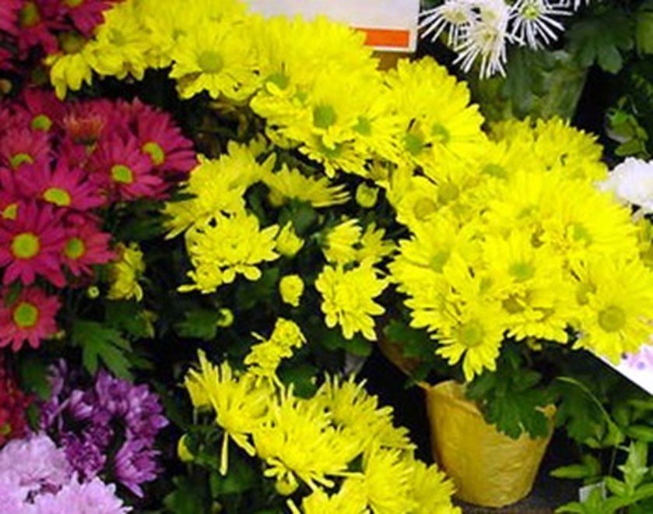
126. Florists Chrysanthemum (Chrysanthemum x morifolium)

Slide 28
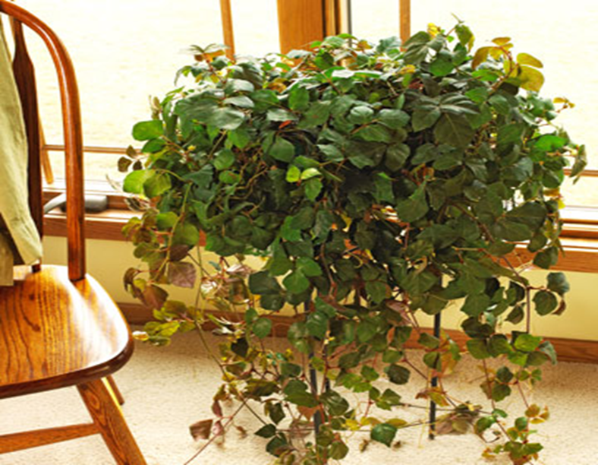
127. Grape Ivy (Cissus rhombifolia)

Slide 29
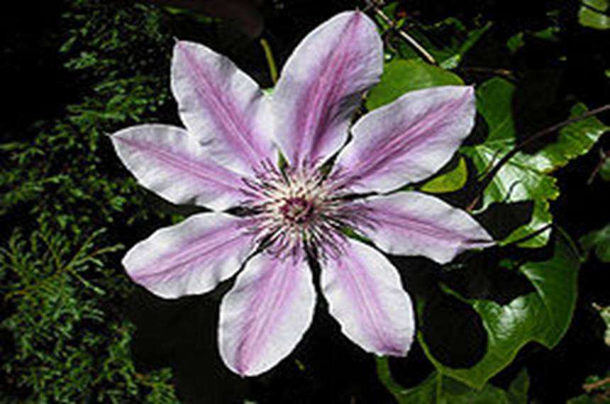
128. Clematis (Clematis Jackmanii Group)

Slide 30
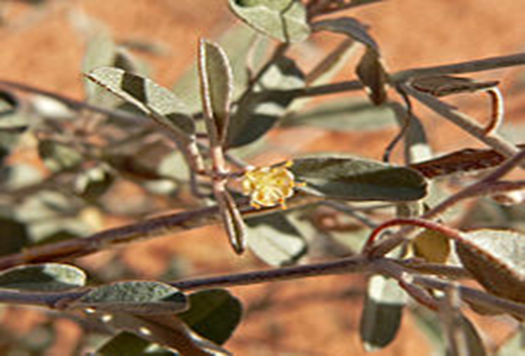
129. Croton (Codiaeum variegatum pictum)

Slide 31
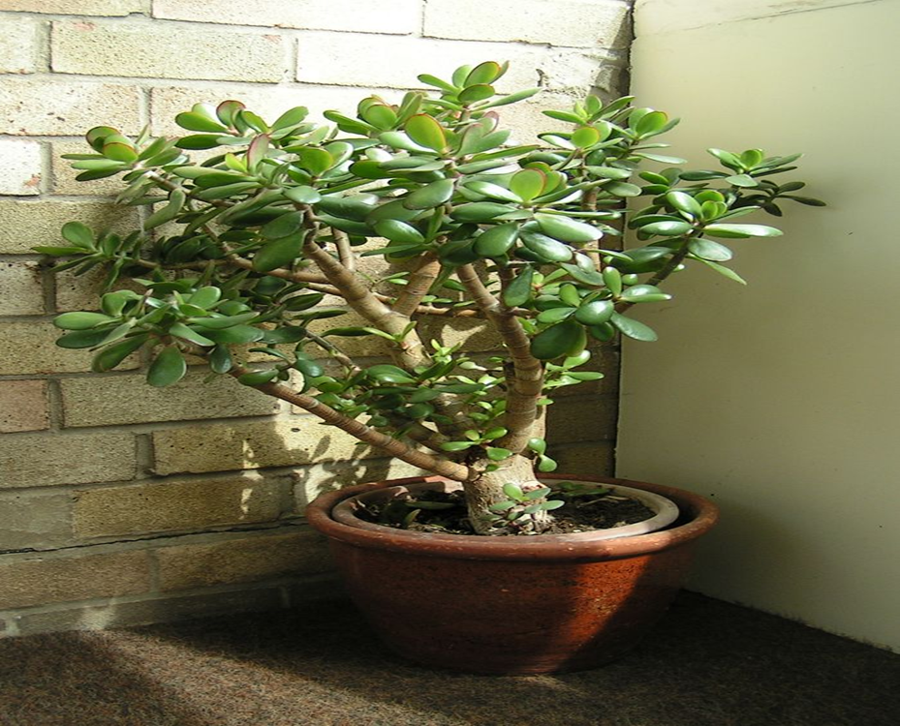
130. Jade Plant (Crassula argentea)

